Slide 1
FastTrack HR & Payroll Solution
Microsoft Dynamics 365 / AX

Slide 2
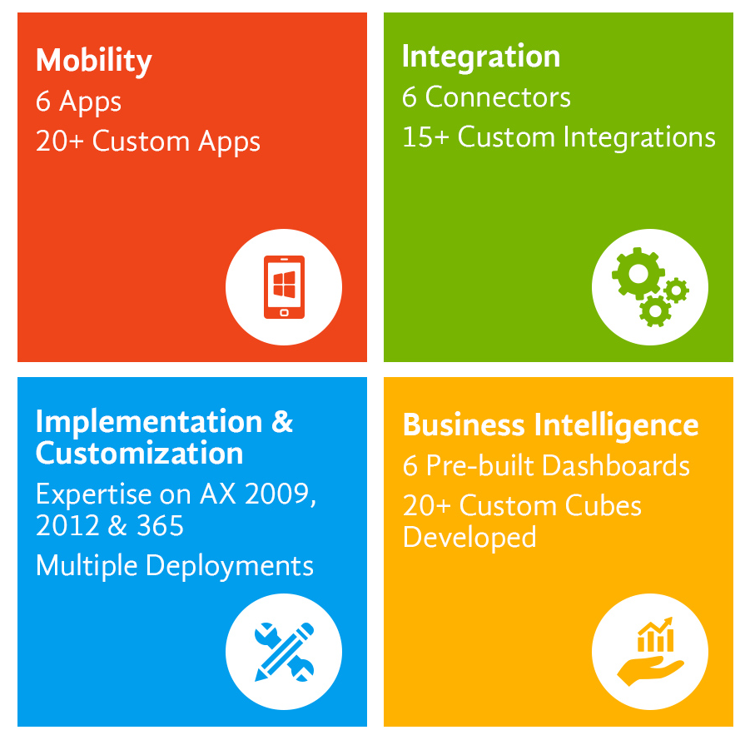
What We Do
Accredited Microsoft partner with over 12 years of experience and a one-stop shop for all your Microsoft Dynamics needs.

Slide 3
Microsoft Dynamics 365/AX FastTrack HR & Payroll

Slide 4
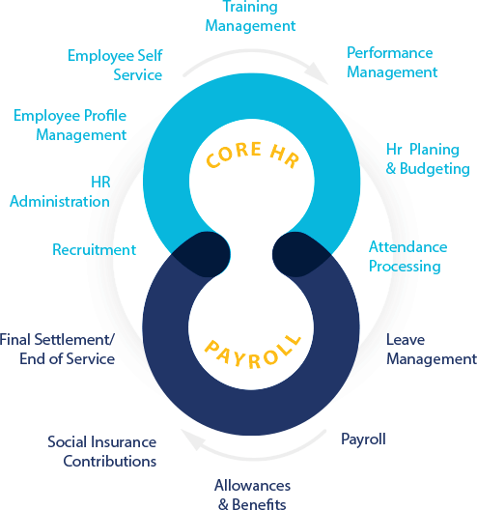
What Dynamics 365 FastTrack Payroll / HR offers

Slide 5
What Dynamics 365 FastTrack Payroll / HR offers
Employee recruitment, approvals, performance & appraisals
Employee hiring to termination processes and reporting
Employee compensation models, promotions and increases
Employee skills & certification tracking and reporting
Employee portal for documents, contact and skills
Employee time & attendance tracking and approvals
W2, W4, 1099 Maintenance
Timesheet entry and approvals for non-clock in employees
Process payroll by batch, legal entity, department and employee
Report for tax

Slide 6
Feature Set for the Payroll:
Single Click Payroll
Allowances & Deductions
Payroll Attendance
Loan Management
Funds Management
Overtime Management
Backdated Payment
Overtime Management
Commission Management
Worker Earning Report
Full-time & Part-time employee payroll processing

Slide 7
Feature Set for the Tax:
Create & Manage Tax Authorities
Create and Manage Tax Tables by Authority
Create Tax Reports for Submission
Tax Calculation as per income Tax Law
Tax Adjustment
Tax Rebates management
Tax Rebates calculation based on investment in mutual Fund
Tax Rebates calculation based on payment of life insurance premium
Other tax deduction on cash withdrawal and utility bills

Slide 8
Human Resources & Payroll Processes:
Employee recruitment, approvals, performance & appraisals
Employee hiring to termination processes and reporting
Employee compensation models
Employee Increments and Promotions
Employee skills & certification tracking and reporting
Employee portal for documents, contact and skills
Employee time & attendance tracking and approvals
Timesheet entry and approvals for non-clock in employees

Slide 9
Human Resources & Payroll Processes (contd.)
Process payroll by batch, legal entity, department and employee
Report for tax
Requisition creation for new hiring & management of approval workflow
Complete hire to terminate processes including documentation, management and reporting
Performance management with templates for teams or individuals and actions
Employee Trainings and Skills development
Employee Goal & Performance Management, Reviews management
Employee Rewards and Recognition
Documentation of employee feedback (positive or negative), required actions and notes

Slide 10
Payroll Feature Set For Specific Countries

Slide 11
Distinct Payroll Feature Set for Pakistan
Data import/export functionality
Reduced the system import (16) entities for the payroll data into 3 entities
Company specific data import and export restrictions
Tax calculation as per PK Tax slabs along with Provident fund as per Pakistan tax rules
Tax certificate for the employees, as per the FBR format along with send as an attachment email functionality along with configurable CPR number and deposit date print on the tax certificate.
Tax rebates calculation based on the investment (e.g. mutual fund) and all other rebates and tax adjustments.
ePayment/tax filling report for uploading on the FBR portal
Bank letter for the pay order generation and EFT file as per bank required format for the EFT processing
Pay slip email functionality
Final settlement

Slide 12
Distinct Payroll Feature Set for Sri Lanka
Data import/export functionality
Reduced the system import (16) entities for the payroll data into 3 entities
Company specific data import and export restrictions
Tax handling
Monthly regular tax calculation
Lump sum tables and Lump sum tax calculation handling
Tax handling for the Termination benefits
Pay slip email functionality

Slide 13
Distinct Payroll Feature Set for Bangladesh
Data import/export functionality
Reduced the system import (16) entities for the payroll data into 3 entities
Company specific data import and export restrictions
Gender based tax calculation
Allowances (House, medical and transportation) exemption handling with cap of exemption amount
Minimum tax handling
TDS report as per the tax authority format for the uploading on the authority portal/website
Bank letter for the pay order generation and EFT file as per bank required format for the EFT processing
Pay slip email functionality

Slide 14
Distinct Payroll Feature Set for Nepal
Data import/export functionality
Reduced the system import (16) entities for the payroll data into 3 entities
Company specific data import and export restrictions
Tax handling
Gender base and Marital status based tax handling
Female rebate handling
Social security tax and Remuneration tax handling
Approved retirement fund handling (PF, CIT,) with cap of Max 300k exemption amount
Medical and life insurance exemption handling
Bank letter for the pay order generation and EFT file as per bank required format for the EFT processing
Pay slip email functionality

Slide 15
Distinct Payroll Feature Set for Myanmar
Data import/export functionality
Reduced the system import (16) entities for the payroll data into 3 entities
Company specific data import and export restrictions
Tax handling
Minimum taxable salary handling
Basic applicable exemption handling
Tax relief handling
Spouse
Number of children’s
Number of parents
SSB

Slide 16
Service Delivery Model

Slide 17
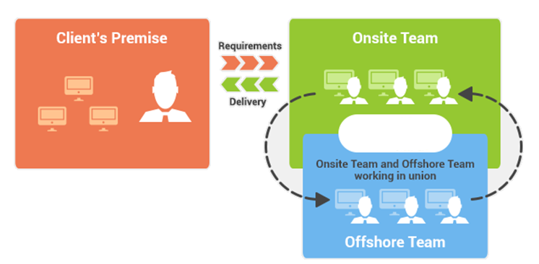
Hybrid (Onshore / Offshore) Delivery Model

Slide 18
Microsoft Dynamics 365/AX FastTrack HR & Payroll Case Study

Slide 19
Daraz – A Rocket Internet Company later acquired by Alibaba Group
Daraz is South Asia’s largest online marketplace that connects sellers and buyers on one platform, it facilitates the exchange of millions of products between millions of customers and thousands of sellers via its app.
Among early adopters of Dynamics 365 for Finance & Operations in the EMEA region.
Running operations in 5 countries with 1600 employees.
Products and services
Organization size
Industry
Location
Company Type
Microsoft Dynamics 365 Finance & Operations Implementation with Payroll and HR
Large (1,001-5,000) employees
Information Technology & Service
Srilanka, Nepal, Pakistan, Bangladesh & Myanmar
Private Limited
Among early adopters of Dynamics 365 for Finance & Operations in the EMEA region. Folio3 successfully implemented Microsoft Dynamics 365 Finance and Operations for Daraz, which was a multi-country implementation spanned in 5 countries in the South Asian region with Supporting Finance, Sales, Supply Chain and HR teams for their functional and technical support issues.

Slide 20
We Are Your Go-To-Experts
Over 12 years of experience with Microsoft Dynamics
Featured Microsoft Mobility Partner
We are a ONE STOP shop for world class expertise in:
Dynamics Mobile Apps
Dynamics AX/365 Connectors
Custom Mobile app development for Dynamics AX/365
Cost Efficient AX/365 Implementations
AX/365 Development & Customizations

