Slide 1
Civility, Safety & Interaction Online
United Kingdom, January 2019

Slide 2
Key Findings – United Kingdom
The nature of online risk types: The types of risks that stood out for the U.K. compared to the global averages included: 1) receiving offensive or obscene content, 2) being called offensive names, and 3) being asked inappropriate and personal questions by a stranger
Our social circles became more risky: Within the U.K., risks from family and friends increased by 5 points to 21%, but the gain was not as pronounced as in other countries
The pain from online risks was lower: Within the U.K., moderate to severe pain was experienced by 49% of respondents, slightly below the global average
Consequences were up; positive actions resulting from an online risk were down: U.K. consumers were in line with the worldwide trend for consequences and positive actions
Millennials were hit hardest by risks: More millennials in the U.K. suffered from moderate to severe pain following online risk exposure compared to their global peers (62% vs. 60%)
Teens asked for help. In the U.K., more teens asked a parent or another adult for help with an online risk vs. the previous year, but the increase was below the global average
UK is top for DCI: The U.K. (-1) registered a small gain in DCI and is ranked #1 of the 22 countries surveyed

Slide 3
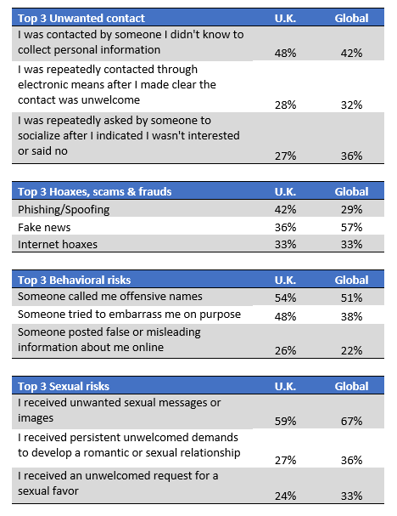
Nature of online risk types in the U.K.
The most common type of unwanted contact in the U.K. involved attempts to collect personal information, a risk that was noticeably higher than the global average
Britons were most likely to encounter phishing/spoofing scams, a risk that significantly outpaced the global average. Fake news was also common risk, but this was significantly lower than the global average
Various forms of bullying were the most typical behavioral risks experienced by Britons; bullying risks were higher in the U.K. compared to the rest of the world
Receipt of unwanted sexual imagery or messages dominated this category both in the U.K. and globally; however, sexual risk exposure was more limited in the U.K.
Q2.01 Please choose which of the following TYPES of Unwanted Contact you have ever experienced. Q2.02 Please choose which of the following TYPES of Hoaxes, scams or, frauds you have ever experienced.
Q2.03 Please choose which of the following TYPES of offensive behavior you have ever experienced. Q2.04. …Please choose which of the following TYPES of Sexual risks you have experienced ever.

Slide 4
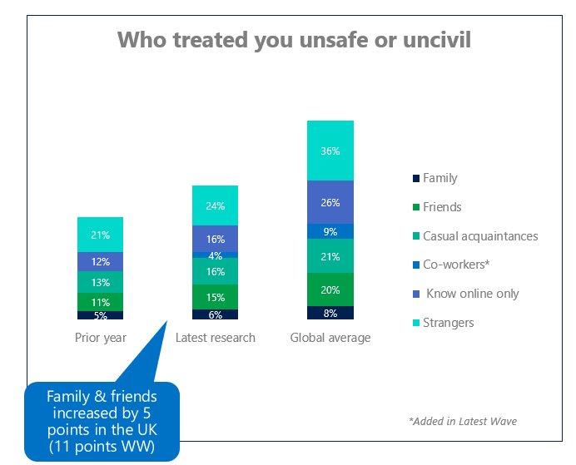
Social circles became riskier in the U.K.
Worldwide, while 62% of online risks were sourced from strangers and people respondents knew online only, family and friends accounted for 28% of online risks, up 11 points YOY
Within the U.K., risks stemming from family and friends also increased (+5 points to 21% vs. the previous year), but the gain was not as pronounced as in other countries
*Added in Latest Wave
Q2a. Which types of people have, in the past treated you in an unsafe or uncivil manner online?
Notes:
JR add

Slide 5
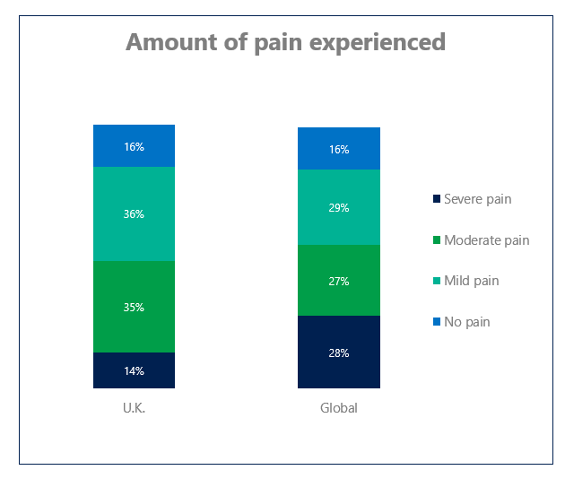
Severe pain from online risks was lower in the U.K.
Worldwide, 55% of consumers reported experiencing moderate or severe pain due to online risks, with 16% saying they felt no pain at all
Within the U.K., moderate to severe pain was experienced by 49% of respondents, 6 points below the global average; Britons also reported half the level of severe pain compared to the rest of the world (14% vs. 28%)
Q5.1: How much emotional, psychological or physical pain did you suffer because of…

Slide 6
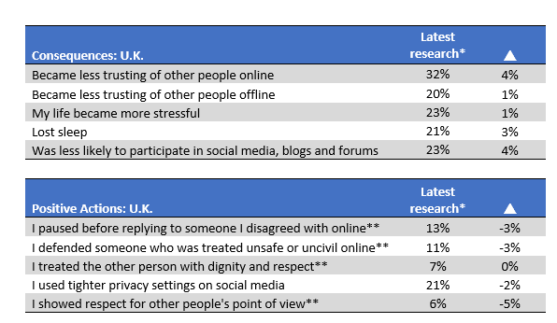
The U.K. had an increase in consequences and a decrease in positive action
Worldwide, there was an increase in consequences and a decrease in positive actions; the top five consequences showed 3- or 4-point increases from the previous year; people also were less likely to take positive actions (-3 to -5 points)
U.K. consumers were in line with the worldwide trend for consequences, and were more likely to say they had lost trust in others online as a result of online risk exposure vs. the prior year
Britons were less likely to take positive actions following an online issue, which is in line with the global average
*Worldwide trend based on 20 countries common in latest research and prior year
**Digital Civility Challenge item

Slide 7
Millennials and teenage girls were hit the hardest
Online risks had some of the strongest impacts on millennials and teenage girls in terms of risk exposure, consequences and the attendant psychological, physical and emotional pain
Overall, exposure to risks as measured by the DCI and average number of risks was lower than the global averages
Millennials in the U.K. suffered slightly greater levels of moderate to severe pain than their global peers (62% vs. 60%)
Q2: Which of these has ever happened to you or to a friend/family member ONLINE? Q9: ….Please tell us if any of the following has ever happened to you or to a friend/family member as a consequence of being treated uncivilly? Q5.1: How much emotional, psychological or physical pain did you suffer because of…

Slide 8
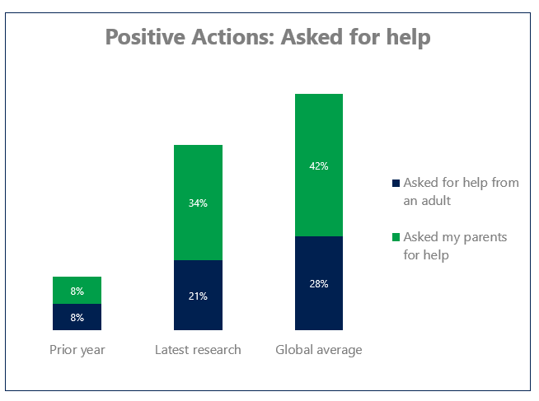
More teens asked for help with online risks
Worldwide, there was a surge in teenagers asking for help with online risks from both parents (+32 points to 42%) and other trusted adults (+19 points to 28%)
In the U.K., more teens asked for help from parents or another adult than the previous year, but the jumps in both groups fell short of the global averages
Asking parents for help jumped 26 points
Asking an adult for help rose 13 points
Q12: Have you ever taken any of the following actions after you were treated in an unsafe or uncivil manner online?

Slide 9
DCI trend
DCI Rank | Country | Region | 2 years ago | prior year | latest research
 | Global |  | 65 | 68 | 66
2 | United States | N. America | 56 | 61 | 51
8 | Canada | N. America |  |  | 60
1 | United Kingdom | W. Europe | 45 | 51 | 50
3 | France | W. Europe | 60 | 58 | 52
4 | Belgium | W. Europe | 59 | 61 | 56
5 | Germany | W. Europe | 62 | 65 | 57
9 | Italy | W. Europe |  | 63 | 62
11 | Ireland | W. Europe |  | 64 | 68
16 | Hungary | CEE |  | 73 | 72
19 | Russia | CEE | 74 | 75 | 74
6 | Malaysia | APAC |  | 56 | 58
7 | India | APAC | 63 | 61 | 59
10 | Singapore | APAC |  |  | 63
15 | Vietnam | APAC |  | 71 | 71
12 | Mexico | Latam | 76 | 71 | 69
13 | Brazil | Latam | 71 | 71 | 70
17 | Colombia | Latam |  | 77 | 72
18 | Argentina | Latam |  | 75 | 74
20 | Chile | Latam | 72 | 73 | 75
22 | Peru | Latam |  | 78 | 79
14 | Turkey | MEA | 71 | 72 | 71
21 | South Africa | MEA | 78 | 77 | 78
Worldwide, Microsoft’s Digital Civility Index (DCI) fell two points from the previous year driven by a widespread decline in unwanted contact
The U.K. (-1) registered a small gain in DCI and is ranked #1 of the 22 countries surveyed in this latest poll
Indeed, the U.K. has chalked up the highest level of perceived civility for the second time in the last three studies
*Worldwide trend based on 20 countries common in latest research and prior year
Q2: Which of these has ever happened to you or to a friend/family member ONLINE?

