Slide 1
Civility, Safety & Interaction Online
Chile, January 2019

Slide 2
Key Findings – Chile
The nature of online risk types: The types of risks that stood out for Chile compared to the global averages included: 1) receiving offensive or obscene content, 2) encountering fake news and internet hoaxes, and 3) receiving persistent demands for an unwanted relationship
Our social circles became more risky: Within Chile, risks from family and friends also jumped to 48%, up 27 points from the prior year and significantly higher than the global average
Severe pain from online risks was slightly lower: In Chile, moderate to severe pain as a result of an online risk was experienced by 50% of respondents, 5 points below the global average
Consequences were up; positive actions were mixed: Chileans had a greater increase in consequences following online risk exposure compared to the global average, but showed mixed results in taking positive actions after risks
Teenage girls were hit hardest: A larger percentage of teenage girls in Chile suffered moderate to severe pain from online risks compared to other age groups
There was a slight decline in teens asking for help. In Chile, teens were slightly less likely to ask a parent for help with an online issue compared to the previous year (25% vs. 27%) – opposite and in stark contrast to the global trend
Drop in Microsoft Digital Civility Index (DCI): Chile (+2) showed a slight drop in DCI and ranks #20 of the 22 countries polled

Slide 3
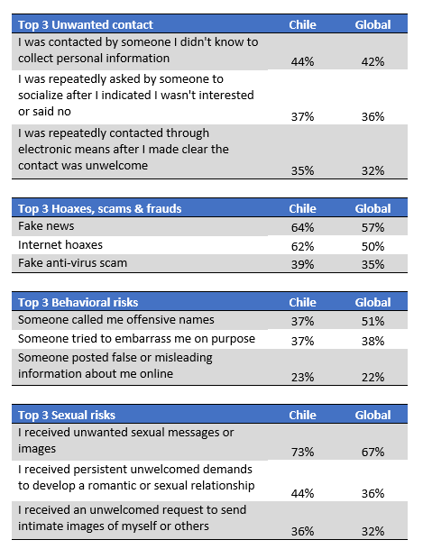
Nature of online risk types in Chile
The most common unwanted contact involved attempts to collect personal information, largely in line with the global average
Chileans were most likely to encounter fake news and internet hoaxes, both noticeably higher than the global averages
Various forms of bullying were the most typical behavioral risks experienced by Chileans, but being called offensive names was markedly lower (-14 points) in Chile compared to the rest of the world
Receipt of unwanted sexual imagery or messages dominated this category both in Chile and globally, with Chile outpacing the rest of the world by 6 points; unwelcomed demands to develop a romantic or sexual relationship were 8-points higher in Chile than the global average
Q2.01 Please choose which of the following TYPES of Unwanted Contact you have ever experienced. Q2.02 Please choose which of the following TYPES of Hoaxes, scams or, frauds you have ever experienced.
Q2.03 Please choose which of the following TYPES of offensive behavior you have ever experienced. Q2.04. …Please choose which of the following TYPES of Sexual risks you have experienced ever.

Slide 4
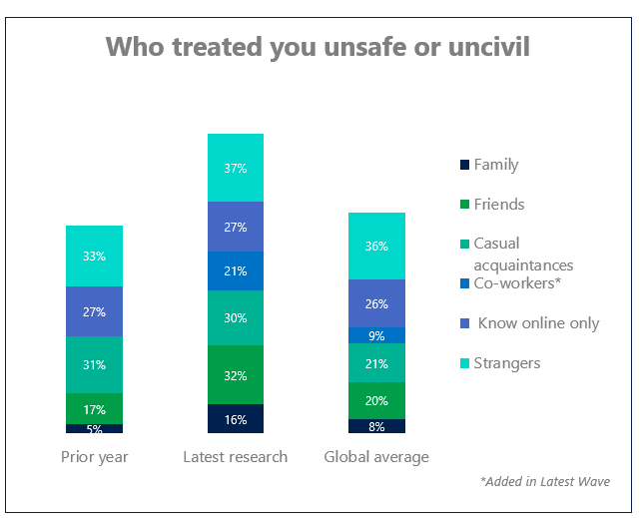
Social circles became riskier in Chile
Worldwide, while 62% of online risks were sourced from strangers and people respondents knew online only, family and friends accounted for 28% of online risks, up 11 points YOY
Within Chile, risks from family and friends also increased to 48%, up 26 points from the previous year and significantly higher than the global average
Risks from family & friends +26 points in Chile
(+11 WW)
*Added in Latest Wave
Q2a. Which types of people have, in the past treated you in an unsafe or uncivil manner online?
Notes:
JR add

Slide 5
Severe pain from online risks was slightly lower in Chile
Worldwide, 55% of consumers reported experiencing moderate or severe pain due to online risks, with 16% saying they felt no pain at all
Within Chile, moderate to severe pain was experienced by 50% of respondents, 5 points below the global average; meanwhile, nearly 1 in 2 (18%) of Chilean respondents said they experienced no pain from online risk exposure
Q5.1: How much emotional, psychological or physical pain did you suffer because of…

Slide 6
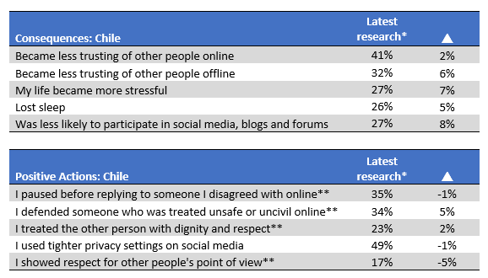
Chile increased in consequences from risks, but showed mixed results in taking positive action after risk exposure
Worldwide, there was an increase in consequences and a decrease in positive actions; the top five consequences showed 3- or 4-point increases from the previous year; people also were less likely to take positive actions (-3 to -5 points)
Chileans had a greater increase in consequences compared to the global average; they were more likely not to participate in social media and became more stressed following online issues
Chile posted mixed results in taking positive actions; they were more likely to defend someone being treated uncivilly online, but were less likely to show respect towards others’ views
*Worldwide trend based on 20 countries common in latest research and prior year
**Digital Civility Challenge item

Slide 7
Teenage girls were hit the hardest
Online risks had some of the strongest impacts on teenage girls in terms of risk exposure, consequences and the attendant psychological, physical and emotional pain
Overall, exposure to risks as measured by the DCI and average number of risks was higher than the global averages
A higher percentage of teenage girls in Chile suffered moderate to severe pain compared to the other age groups
Q2: Which of these has ever happened to you or to a friend/family member ONLINE? Q9: ….Please tell us if any of the following has ever happened to you or to a friend/family member as a consequence of being treated uncivilly? Q5.1: How much emotional, psychological or physical pain did you suffer because of…

Slide 8
Fewer teens asked for help with online risks in Chile
Worldwide, there was a big surge in teenagers asking for help with online risks from both parents (+32 points to 42%) and adults (+19 points to 28%)
In Chile, teens were slightly less likely to ask for help from a parent compared to the previous year; this was opposite and in stark contrast to the global trend
Asking parents for help fell 2 points
Asking another adult for help rose 2 points
Q12: Have you ever taken any of the following actions after you were treated in an unsafe or uncivil manner online?

Slide 9
DCI trend
DCI Rank | Country | Region | 2 years ago | prior year | latest research
 | Global |  | 65 | 68 | 66
2 | United States | N. America | 56 | 61 | 51
8 | Canada | N. America |  |  | 60
1 | United Kingdom | W. Europe | 45 | 51 | 50
3 | France | W. Europe | 60 | 58 | 52
4 | Belgium | W. Europe | 59 | 61 | 56
5 | Germany | W. Europe | 62 | 65 | 57
9 | Italy | W. Europe |  | 63 | 62
11 | Ireland | W. Europe |  | 64 | 68
16 | Hungary | CEE |  | 73 | 72
19 | Russia | CEE | 74 | 75 | 74
6 | Malaysia | APAC |  | 56 | 58
7 | India | APAC | 63 | 61 | 59
10 | Singapore | APAC |  |  | 63
15 | Vietnam | APAC |  | 71 | 71
12 | Mexico | Latam | 76 | 71 | 69
13 | Brazil | Latam | 71 | 71 | 70
17 | Colombia | Latam |  | 77 | 72
18 | Argentina | Latam |  | 75 | 74
20 | Chile | Latam | 72 | 73 | 75
22 | Peru | Latam |  | 78 | 79
14 | Turkey | MEA | 71 | 72 | 71
21 | South Africa | MEA | 78 | 77 | 78
Worldwide, Microsoft’s Digital Civility Index (DCI) fell two points from the previous year driven by a widespread decline in unwanted contact
Chile (+2) registered a small drop in DCI and ranks #20 of the 22 countries surveyed
*Worldwide trend based on 20 countries common in latest research and prior year
Q2: Which of these has ever happened to you or to a friend/family member ONLINE?

