Slide 1
Digital display units
This template is for informational purposes only. MICROSOFT MAKES NO WARRANTIES, EXPRESS, IMPLIED, OR STATUTORY, AS TO THE INFORMATION IN THIS DOCUMENT. © 2016 Microsoft Corporation. All rights reserved.

Slide 2
Windows 10 just keeps
getting better!
Update today
and do great things.
<insert intranet URL for more info>
<insert company logo>

Slide 3
Update Windows 10 and do great things!
Windows as a Service
means that Windows just
keeps getting better.
<insert intranet URL for more info>
<insert company logo>

Slide 4
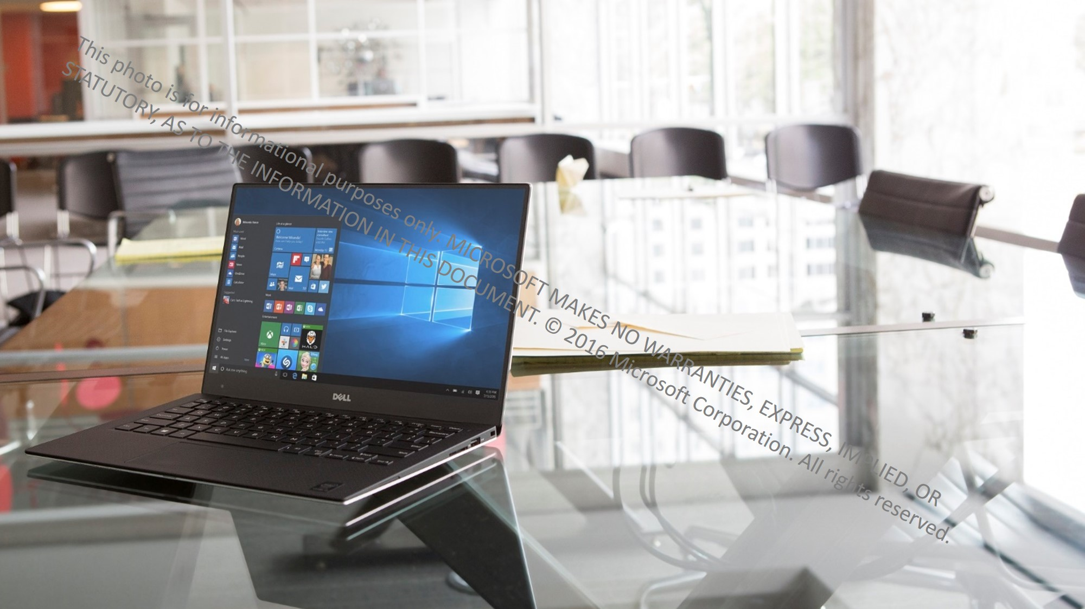
Windows 10 just keeps
getting better!
Update today
and do great things.
<insert intranet URL for more info>
<insert company logo>

Slide 5
Windows 10
just keeps getting better!
Update today
and do great things.
<insert intranet URL for more info>
<insert company logo>

Slide 6
Update Windows 10 and do great things!
Windows as a Service means that Windows just keeps getting better.
<insert intranet URL for more info>
<insert company logo>

Slide 7
Windows 10
just keeps getting better!
Update today
and do great things.
<insert intranet URL for more info>
<insert company logo>

Slide 8
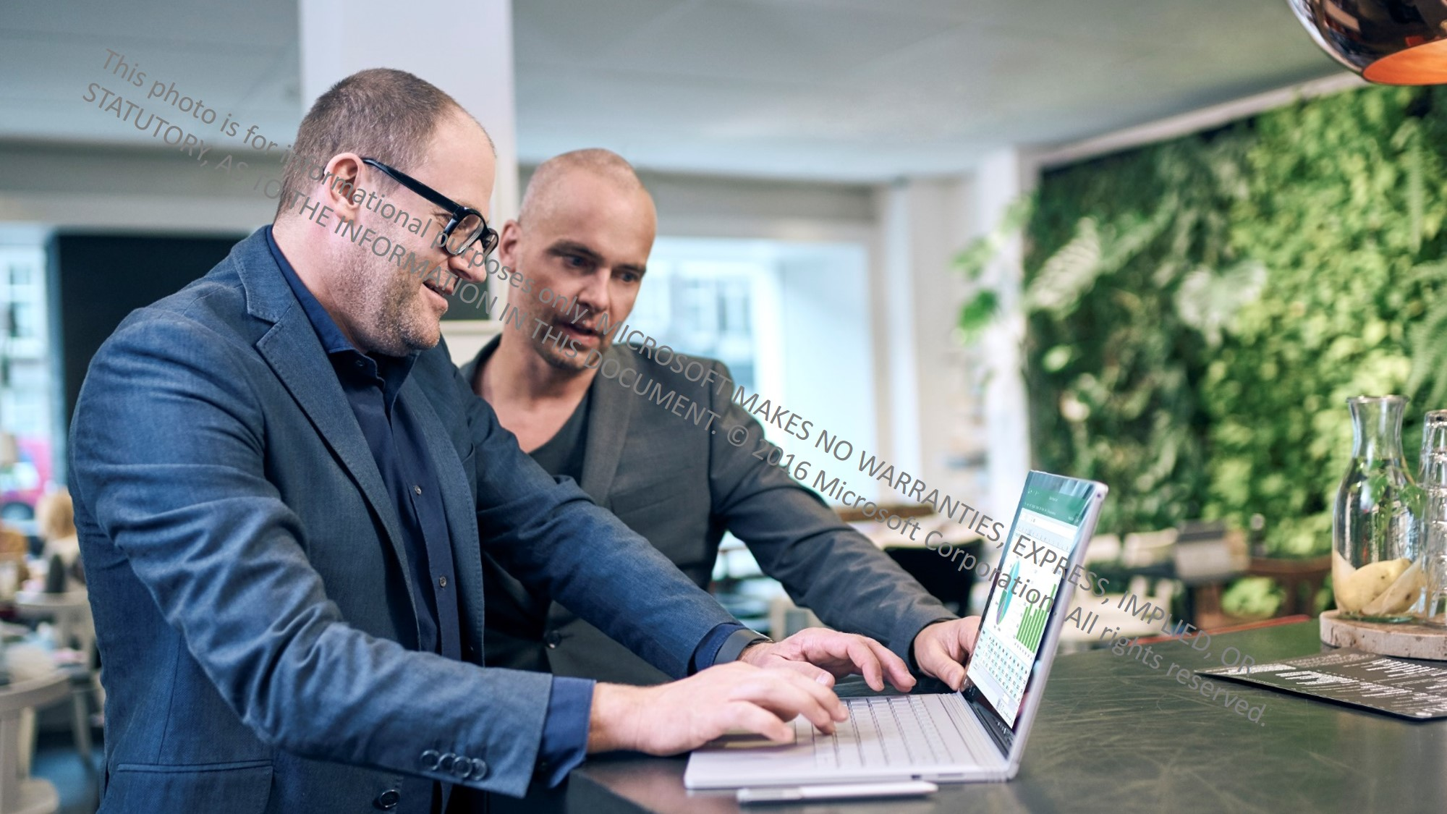
Update Windows 10 and do great things!
Windows as a Service means that Windows just keeps getting better.
<insert intranet URL for more info>
<insert company logo>

Slide 9
Windows 10
just keeps getting better!
Update today
and do great things.
<insert intranet URL for more info>
<insert company logo>

Slide 10
Windows 10
just keeps getting better!
Update today
and do great things.
<insert intranet URL for more info>
<insert company logo>

