Slide 1
Cloud Migration

Slide 2
Incremental Group
Incremental Group is a digital transformation services provider and leading Microsoft partner. We provide a full range of consultancy, implementation and support services across the following areas:
Cloud and Apps
Dynamics
Data and AI
Notes:
We are a leading Microsoft partner, that provides digital services. We are a one stop shop for all things Microsoft
We split our services into three distinct areas:
Cloud and Apps – This area of the business is focused on supporting organisations on the journey to the cloud, application modernisation and Office 365. Focused on modernising your IT and helping your digitally transform.
Dynamics 365 – We have split the Dynamics 365 range into 3 areas (CE, BC + F+O) We do cover the entire range of Dynamics 365 and we actually provide supporting services to legacy Dynamics products such as Dynamics NAV, AX, GP and CRM.
Data and AI –data is now the lifeblood of your organisation and our team of data specialists help you tap into and make the most of that data. They provide data engineering, business intelligence, Power BI and Data Science services.
We also provide digital transformation and support services.

Slide 3
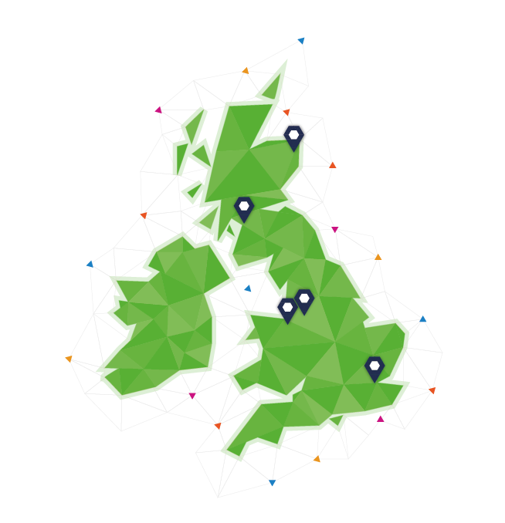
UK wide
We have over 150 Incrementalists, in offices across the UK.
Our offices are in Manchester, Aberdeen, London, Glasgow and Northwich.

Slide 4
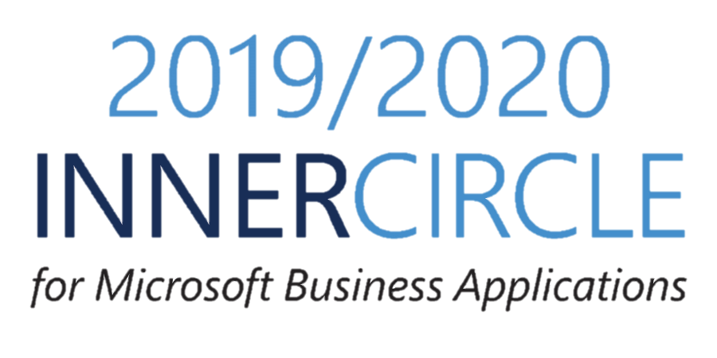
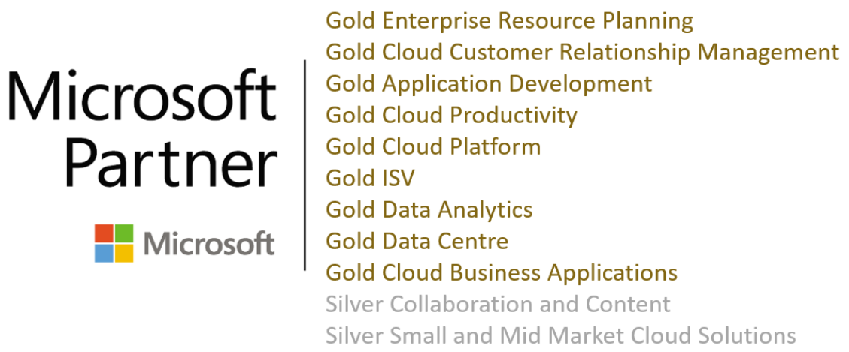
Microsoft partner
Microsoft partner
Notes:
We are a leading Microsoft partner, holding 7 gold competencies and 3 silver competencies.
We are also part of the 2019/2020 Inner circle for business applications. This recognises Incremental Group as one of Microsoft leading Business Applications partners in the world.

Slide 5
Cloud and Apps services
Our cloud and apps team helps our customers embrace the latest digital technology and embrace the cloud.
Cloud and Infrastructure
Office 365
Applications
Our Cloud and Apps team is made up of developers, cloud specialists and Office 365 consultants. They hold 5 Microsoft gold competencies.
Notes:
We are a leading Microsoft partner, that provides digital services. We are a one stop shop for all things Microsoft
We split our services into three distinct areas:
Cloud and Apps – This area of the business is focused on supporting organisations on the journey to the cloud, application modernisation and Office 365. Focused on modernising your IT and helping your digitally transform.
Dynamics 365 – We have split the Dynamics 365 range into 3 areas (CE, BC + F+O) We do cover the entire range of Dynamics 365 and we actually provide supporting services to legacy Dynamics products such as Dynamics NAV, AX, GP and CRM.
Data and AI –data is now the lifeblood of your organisation and our team of data specialists help you tap into and make the most of that data. They provide data engineering, business intelligence, Power BI and Data Science services.
We also provide digital transformation and support services.

Slide 6
Cloud migration
Our cloud migration approach is designed around you, with a plan to move your digital estate to the cloud at a pace that suits you. Our cloud team are Citrix and Azure specialists.
Our services include:
Cloud migration, deployment strategy and services
SQL Server on-premises to IaaS, PaaS or Hybrid migrations
Legacy ERP, such as NAV, GP and AX to Azure VMs
Office 365 migrations
Citrix deployment
Azure migration

Slide 7
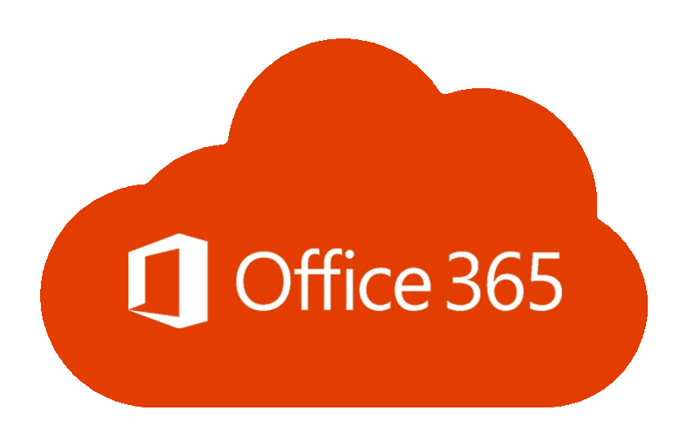
Office 365
We help organisations improve their productivity and make the most of the full range of Office 365 applications. We are a Microsoft gold partner for Cloud Productivity and a silver for Collaboration and Content.
Improve communication and collaboration inside your organisation with the full suite of communication tools in Office 365, including Microsoft Teams
Take SharePoint to the next level, improving document management and intranet sites that support your employees
Empower citizen development using PowerApps and Flow to streamline and automate everyday business processes

Slide 8

Applications
Our expertise lies in taking complex legacy applications and making them work better for our customers and building new custom applications. Our services include:
Migrating bespoke applications to the cloud
Application modernisation
Application virtualisation and access improvements
Application support and maintenance

Slide 9


Microsoft Power Platform
One connected platform that empowers everyone to innovate
Build web and mobile apps fast and
without limits
Automate and integrate business processes with your applications
Gain insights from your data regardless of where it lives
We help organisations empower their citizen developers, connect their applications and build custom applications and dashboards for their employees. All utilising the low code approach of the Power platform.

Slide 10
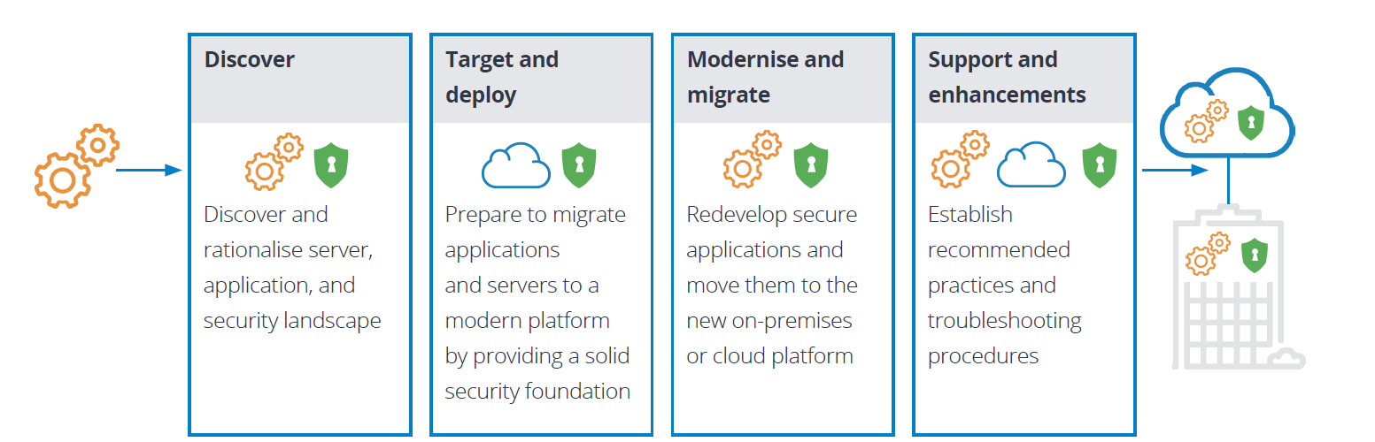
Cloud migration methodology
Notes:
The Modern Data Platform is a product agnostic journey that is tailored for a customer’s needs and scales as their business grows. Each stage provides a tangible output.

Slide 11





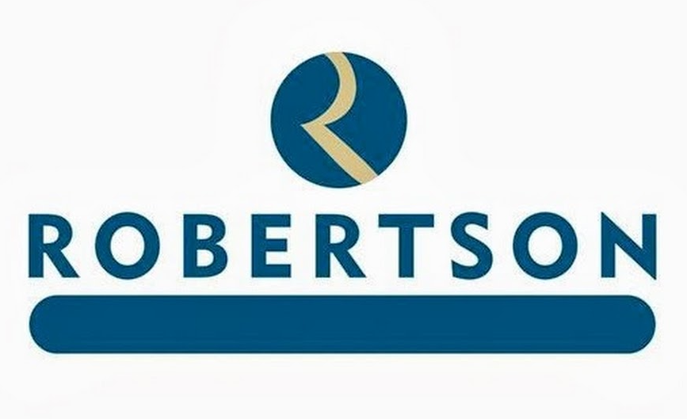





Cloud customers

