Slide 1
©2019 Smartronix, Inc. | www.cloudassured.com CMMI DEV/3 & SVC/3 | ISO 9001 & 20000 & 27001 | SOC 1 & 2

Slide 2
Who We Are
Smartronix is a U.S. based, unique, end-to-end global professional solutions provider specializing in cloud computing, cyber security, and engineering solutions for defense, federal, public sector, and commercial enterprise customers.
As a leader in securely shaping IT transformation through cloud, our solutions have helped many organizations successfully address the complexities associated with cloud migrations, design, and security. For the past 25 years, Smartronix has built a worldwide team with innovative technical expertise to deliver critical solutions that assure our customer’s missions.
Founded in 1995
750+ Employees
$420M+ Revenue
2017 Top 100
2008 – 2017
Top Ranked Technology Firm
Notes:
Smartronix has been in business for about 25 years as a high security IT services provider

Slide 3
Our Relationship with Microsoft
Inaugural Azure CSP Partner
1st Tier Azure CSP
Federal Rising Partner of the Year
Finalist for Portals and Collaboration Partner of Year (twice)
Inaugural PC2P Reseller program (only 5 invited to participate)
Gold Cloud Platform, Datacenter, App Dev
Microsoft Azure Audited MSP
Gold · Cloud Platform Gold · Datacenter Gold· Application Development
Azure –1st Tier CSP
Authorized Government Reseller
Notes:
Mention Gartner Strengths

Slide 4
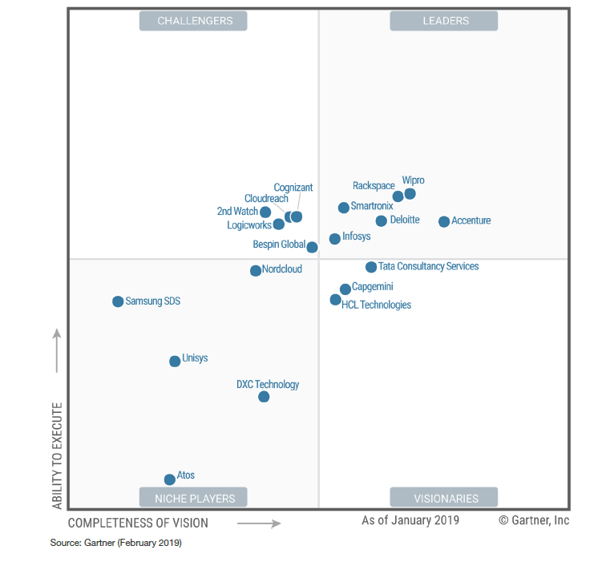
Where Gartner Positions Us
Smartronix positioned as leader in Gartner MQ for public cloud infrastructure MSPs worldwide
Gartner’s recommended use: Nearly all cases (Agile applications, Reliable applications, lift-and-shift datacenter, and Cloud-enabled virtual automation)…especially for companies in regulated industries or government customers:
One of longest track records on AWS and among first Azure MSPs
Provide hybrid, multi-cloud and application management
One of the largest cloud MSPs by VM count as well as by cloud MSP revenue
High customer satisfaction and many large-scale implementations
Can deliver managed services in a DevOps oriented fashion or more traditional and customized
Well structured, automation-supported offerings for customers
Smartronix
January 2019 Gartner Magic Quadrant for Public Cloud Infrastructure Managed Service Providers, Worldwide https://gartnermq.smartronix.com/

