Slide 1
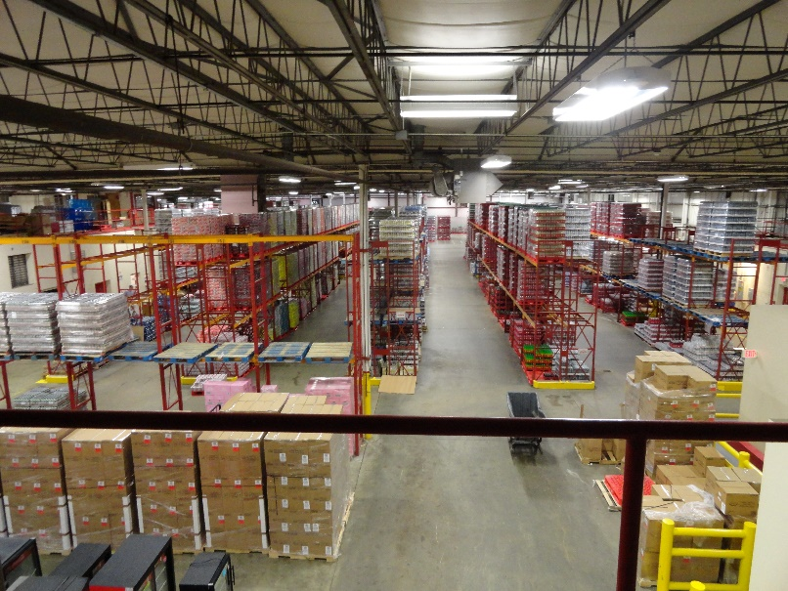
Microsoft Dynamics 365 Business Central
for
Distributors

Slide 2
Assessment
Interview
Discuss goals of new solution
Review order flow as it “should be”
Review warehouse processes
Determine warehouse readiness
Discuss shipping functions
Review reporting requirements for business critical information
Interview takes place over the phone/screenshare and takes less than one hour.

