Slide 1
Sonata Accelerated Upgrade Assessment
Accelerated Direct Upgrade Dynamics AX to Dynamics 365

Slide 2
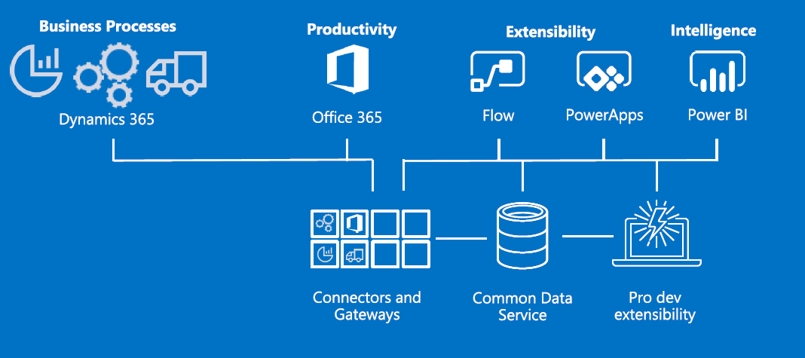
Grow, evolve, and transform business with Dynamics 365
Why should you consider upgrading to Dynamics 365
Engage customers
Empower employees
Optimize operations
New Business Models
Automate processes
Real Time Intelligence
Platform Innovations
Drive Transformation

Slide 3
Typical Upgrade Challenges and Questions
What are the benefits to Business ?
Upgrade vs Re-Implement ?
What happens to the Customizations and Interfaces?
How do the licenses transition ?
How long will this take?
Cloud ? or On-Premise ? Why Choose ?
How much will it cost ?

Slide 4
Sonata Accelerated Upgrade Assessment @ $15,000 USD
Week 1
Week 2
Week 3
Functional Assessment
Tools and Resources
Functional Assessment Report
Technical Assessment
Modules, Customizations, Documentation
Assessment Questionnaire (Sonata)
Upgrade Assessment
LCS Upgrade analysis tool (Microsoft)
Technical Assessment Report
Customizations and Integrations
Extended Analysis tool (Sonata)
Architecture, Deployment Approach
Integration approach
Code Migration Tool (Sonata)
Architecture Assessment
Assessment Checklist (Sonata)
Upgrade Strategy
High Level Upgrade Plan
Estimates & Contract
Upgrade Readiness Check

Slide 5
Contact Sonata for Risk Free Upgrade Path @ 15,000USD
Global Upgrade Expertise
Proprietary toolset : 30-60 % reduction in cost & effort
Dedicated Upgrade Factory
Lifecycle Services
12+ Years Experience 600+ resources on Dynamics 365 with global presence
180+ Engagements
large global & complex upgrades, implementation & rollouts
Dynamics 365 Ready , Industry specific solutions for Retail & Distribution
@ AppSource
Analysis framework for planning your Dynamics 365 journey
Comprehensive skills on Azure, PowerBI, Cortana Analytics , and ,PowerApp, Flow, 0ffice 365
Recognized as Partner for Microsoft ISV Development Center for Dynamics Operations and CRM across the globe

