Slide 1
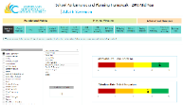
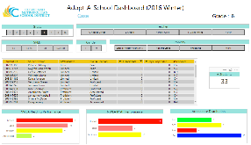
1
0
1
0
1
0
1
0
0
1
1
1
ERW
PowerApps Scoping Workshop
Neal Analytics is Microsoft’s Business Analytics Partner of the Year 2017, with a business unit focused on business application development & data visualization. In order to help as many customers as possible, Neal Analytics has prepared a consulting package called “PowerApps Scoping Workshop” in partnership with Microsoft. This week-long engagement, with a two day on-site workshop is designed to help your team scope your PowerApps deployment. During this workshop, Neal Analytics will work with you to scope a PowerApp. At the end of the workshop, you’ll prepared to embark on a successful PowerApps project & implementation
My company lacks quality data. How can you help with my data management problem? |  | PowerApps comes with a construct called the Common Data Model. Appropriate use of this construct can lead to resolution of data problems.
What’s the cost? |  | $ 15,000
I’m interested, but have concerns around security. |  | Neal Analytics integrates our data management layer with your active directory using Azure, Microsoft’s cloud. This allows us to show the right data to the right people. Microsoft Azure even allows us to obfuscate the data, so Power BI users see only the data where they have the permissions.
How do I get started? |  | Simply contact info@nealanalytics.com! Neal Analytics wants to talk with you about your data needs, and help you get started.
During this Workshop, Neal Analytics will
Provide your team with an in-depth overview of PowerApps | Scope detailed PowerApp implementations | Lead a hands-on workshop demoing PowerApp functionality | Scope configuration of back-end data sources & security requirements. | Walk through the key features of PowerApps, accelerating your team’s journey

