Slide 1
Nero Blanco Service Offering – Disaster Recovery as a Service
Azure Resilience Implementation Service

Slide 2
Azure Resilience Implementation Service
“Whilst the pace of technology development moves at lightning speed, the role it plays in society and how it supports business simply becomes more fundamental.
So it’s no surprise cyber-attacks, data breaches and unplanned IT outages remain the top threats – if these threats are exposed, the impact can be significant to operations and ultimately reputations.
We saw a number of examples hit the headlines in 2017 from healthcare organizations to financial service firms, bringing these threats closer to home and making it real.”
Download the Report here: BCI-Horizon-Scan-Report-2018

Slide 3
Azure Resilience Implementation Service
“Embedding business continuity and sharing the results of horizon scanning analysis with professionals from various disciplines (such as risk, physical security or disaster recovery) is key to building resilience.
This report aims to show why this is the case and to raise awareness among professionals from several regions, sectors and industry roles.”
David Thorp
Executive Director, BCI
Download the Report here: BCI-Horizon-Scan-Report-2018

Slide 4
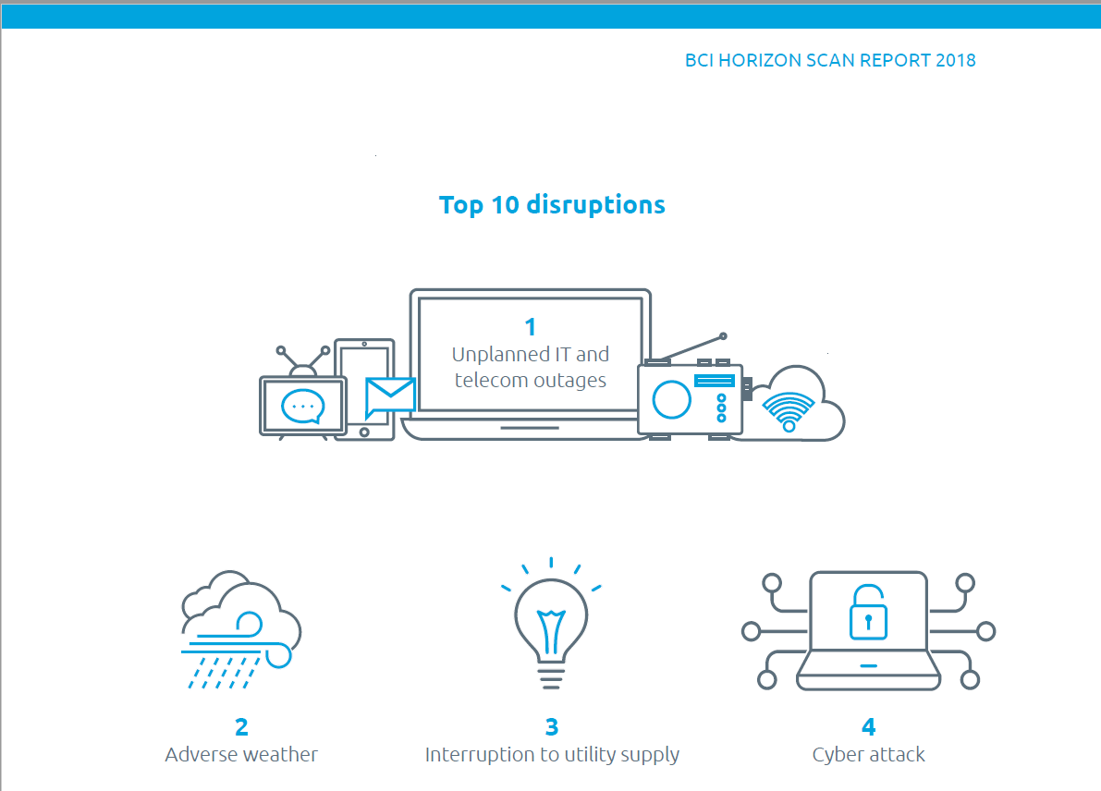
Azure Resilience Implementation Service
BCI Horizon Scan Report 2018
Download the Report here:
BCI-Horizon-Scan-Report-2018

Slide 5
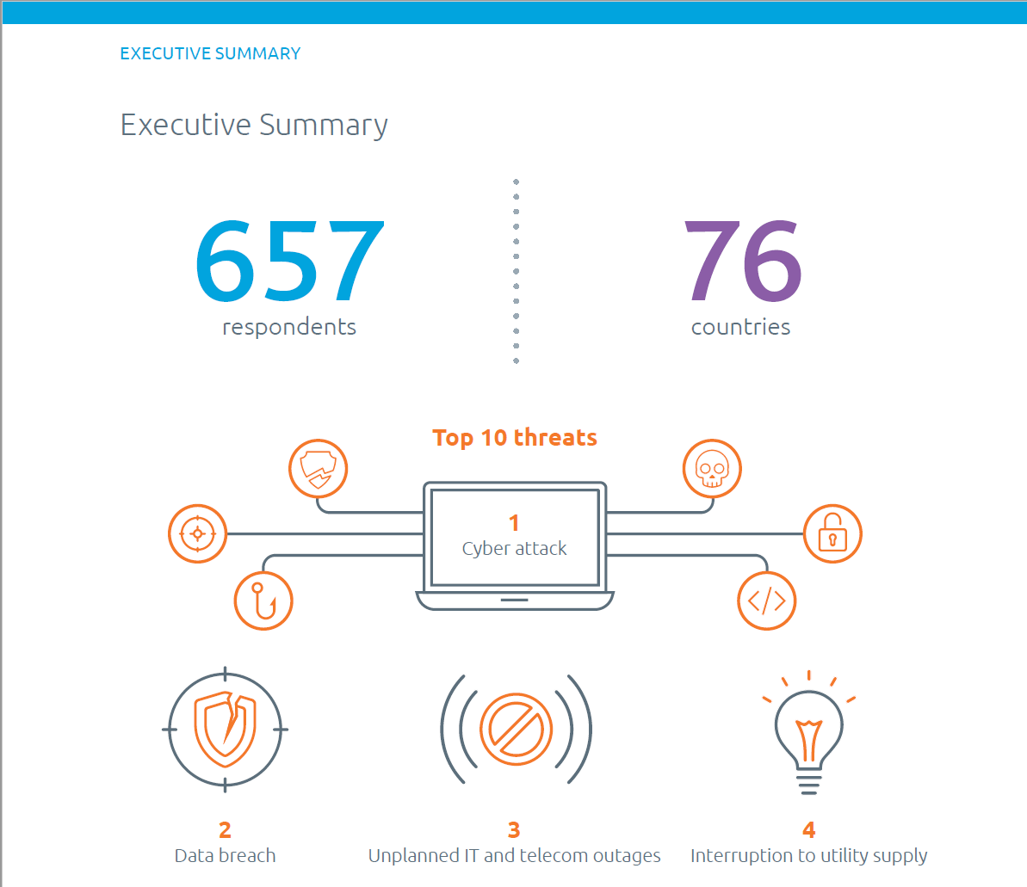
Azure Resilience Implementation Service
BCI Horizon Scan Report 2018
Download the Report here:
BCI-Horizon-Scan-Report-2018

Slide 6
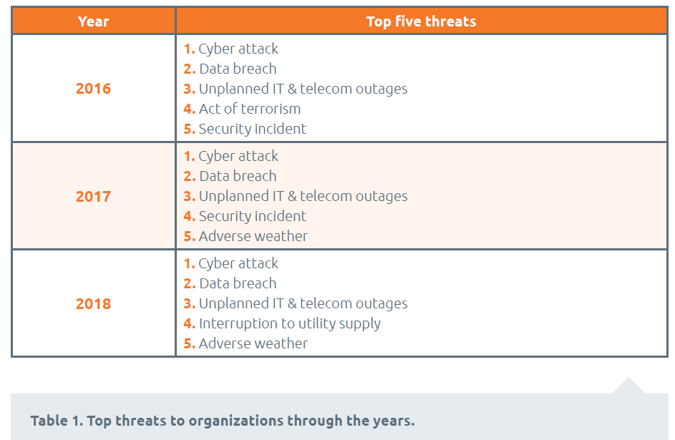
Azure Resilience Implementation Service
BCI Horizon Scan Report 2018
Download the Report here:
BCI-Horizon-Scan-Report-2018

Slide 7
Azure Resilience Implementation Service
Disaster Recovery as a Service
Active/Passive DR to Azure
Regular DR testing
Choice of SLAs
Can be a precursor to migration to Azure

Slide 8
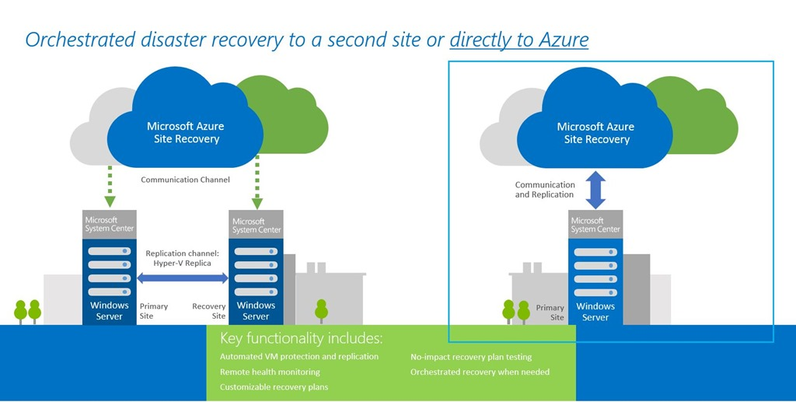
Azure Resilience Implementation Service
Disaster Recovery as a Service
With Nero Blanco’s Azure Resilience we will implement a DRaaS solution for your business critical workloads from your data centre into Azure with Azure Site Recovery.
Azure Resilience is suitable for in-house data centres with VMware VM’s, Hyper-V VM’s, and/or physical servers (Windows and Linux).

Slide 9
Azure Resilience Implementation Service
General Service Description
Azure Resilience is a public cloud-based managed disaster recovery service offering from Nero Blanco, which is based on Microsoft’s Azure Site Recovery capability. Azure Resilience can be used to protect workloads running on Hyper-V, VMware and physical servers and uses Azure as your disaster recovery site. This service offering covers the following workload failover scenario:
Failover Scenario: On-premise to Microsoft Azure
Azure Resilience coordinates and manages the ongoing replication of data by integrating with existing technologies, including System Center and SQL Server Always On. Customer data that is being replicated to Azure is encrypted in transit and can be encrypted at rest as well if required.
Nero Blanco automates the orderly recovery of services in the event of a site outage at the primary data centre - where applications (even complex multi-tier workloads) can be re-instated in an orchestrated fashion to restore service quickly. Azure Resilience monitors the state of your protected instances continuously and remotely from Azure.
As part of the service onboarding, Nero Blanco will perform an assessment of the customer’s in-scope critical workloads (i.e. their underpinning applications, interfaces and infrastructure). Then develop a comprehensive failover service, which includes the creation and maintenance of a failover runbook, monitoring and scheduled rehearsals. In addition, Nero Blanco will work with the customer to devise appropriate failback measures.

Slide 10
Azure Resilience Implementation Service
Business Value
The benefits to customer consuming Azure Resilience are as follows:
Improved time to value over traditional business continuity and recovery services. Service can be deployed rapidly with next to no impact on your internal support teams and/or skills requirement
Reduce costs and adopt pay-per-use model (e.g. pay for compute resources only when executing a recovery plan)
Fits in with the needs of your business and works around their schedules with:
Flexible failover testing options (e.g. choose quarterly, half-yearly, or yearly recovery plan testing)
Easily add ad-hoc testing
Access to Microsoft experts via Nero Blanco
No requirement to have an Enterprise Agreement for Azure with Microsoft
Comprehensive recovery plan for incremental costs above the base price of protecting a VM on Azure

Slide 11
Azure Resilience Implementation Service
Who May Use the Service?
The service is aimed at business architects, IT architects, CIO/CTOs and others responsible for overall solutioning and service delivery into an organisation.
Deliverables and Outcomes
The following are the deliverables and outcomes of the Azure Resilience Service.
The production and sign-off of appropriate services relating to:
Recovery Configuration
Replication Monitoring
Failover-Test
Recovery Management
Reporting and Advisory
Incident Management
Procedures Manual

Slide 12
Please contact us here:
team@neroblanco.co.uk

