Slide 1
Nero Blanco Service Offering
Azure Resilience

Slide 2
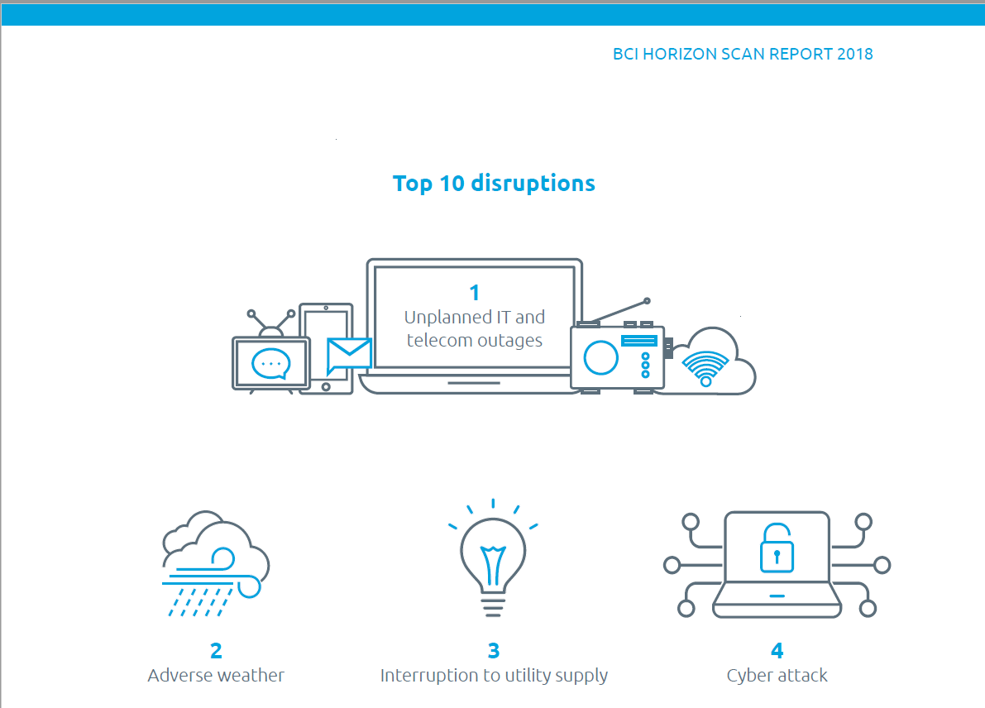
Nero Blanco Service Offering – Azure Resilience
BCI Horizon Scan Report 2018
Download the Report here:
BCI-Horizon-Scan-Report-2018

Slide 3
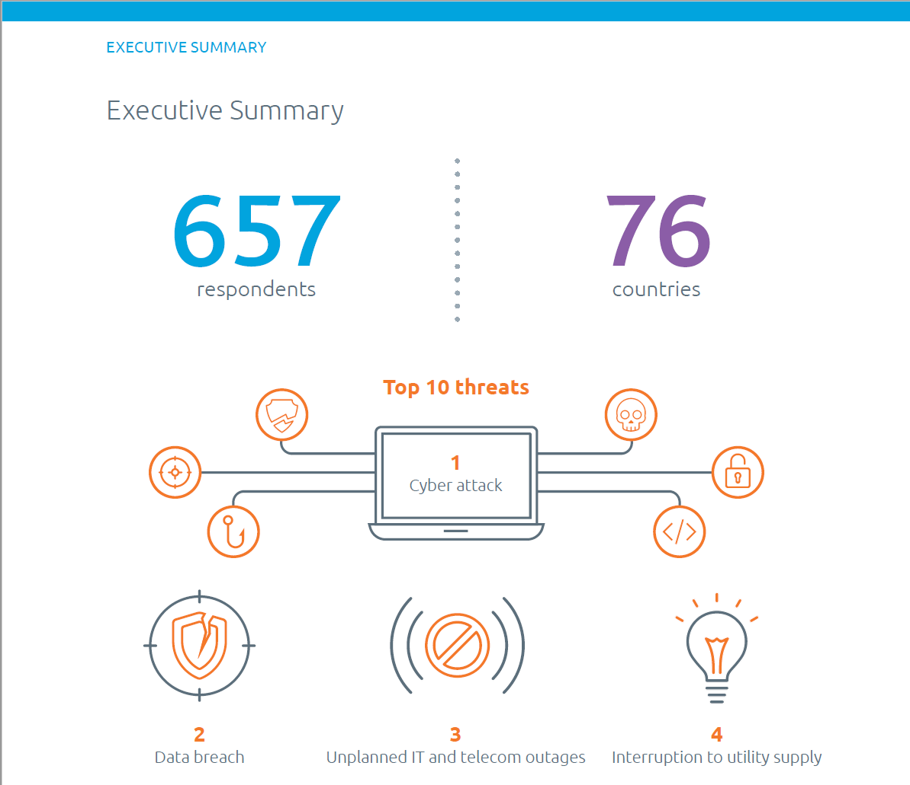
Nero Blanco Service Offering – Azure Resilience
BCI Horizon Scan Report 2018
Download the Report here:
BCI-Horizon-Scan-Report-2018

Slide 4
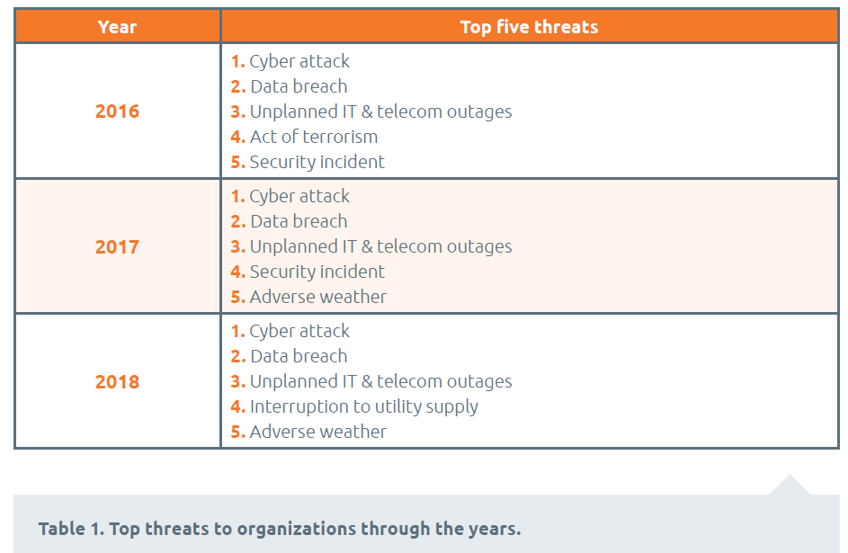
Nero Blanco Service Offering – Azure Resilience
BCI Horizon Scan Report 2018
Download the Report here:
BCI-Horizon-Scan-Report-2018

Slide 5
Nero Blanco Service Offering – Azure Resilience
Disaster Recovery as a Service
Active/Passive DR to Azure
Regular DR testing
Choice of SLAs
Can be a precursor to migration to Azure

Slide 6
Nero Blanco Service Offering – Azure Resilience
Disaster Recovery as a Service
With Nero Blanco’s Azure Resilience Proof of Concept (POC), we will implement a DRaaS solution for a sample of your workloads from your data centre into Azure with Azure Site Recovery.
This PoC is suitable for in-house data centres with VMware VM’s, Hyper-V VM’s, and/or physical servers (Windows and Linux).
The PoC will deliver a DR solution for up to 3 workloads leveraging Azure Site Recovery into a single Azure region, with a target RPO and RTO of less than 15 minutes.

Slide 7
Please contact us here:
team@neroblanco.co.uk

