Slide 1



Team Connection Day event-in-a-box
Team Connection Day event-in-a-box
The following slides are meant to be edited and customized for your organization/team.

Slide 2

Team Connection Day event-in-a-box contents
Team Connection Day event-in-a-box
What’s included?
Host speaker notes
Team Connection Day presentation slides (customizable) including:
Welcome
Agenda
Human Energy Crisis overview
Team Connection Day objectives & collective agreements
Connection Activity 1
Connection Activity 2
Closing
Each slide has the following information in the notes section:
Timing: expected time for each slide.
Say: customizable talking points for each slide and instructions and actions required for activities.
Please customize the slides and images to your organization and/or team.

Slide 3

Team Connection Day
Notes:
Timing: 30 seconds
Who: Host - (insert name)
Say:
Hello everyone and welcome to our first-ever Team Connection Day!
I’m [Host name] and I’m excited and honored to be here with you as we come together to check-in, listen, and define what connection looks like for our team/community.
Thank you to the Connection Day Team and everyone involved in making this day come to life.
We have activities planned to get us sharing and building trust.
(Optional) Recorded video or in-person: But before we dive in, we have a few words from our leader on what we hope to accomplish today

Slide 4
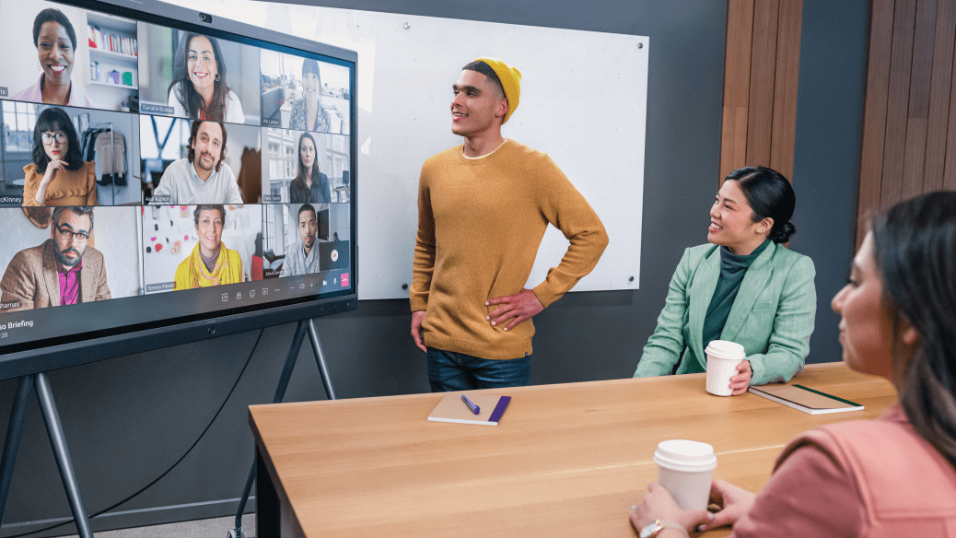
Welcome
Welcome
Host Name
Title
Notes:
Timing: 2-5 min
Who: Host
Say: Host encouraged to tailor comments before session.
Hello everyone! It’s great to be with you today in person and thank you all for prioritizing being here. I am seeing many familiar faces and many new ones and I can’t wait to connect and reconnect throughout the day.
Now that the world is a different place, connection has taken on a whole new meaning for many of us and today is all about experimenting with connection as a function. Making space and time to try it, reflect, and share.
The Human Energy Crisis is and the need for all of us to have more sustainable energy.
Today is our opportunity to explore how team connections can help sustain our energy and how we’ll stay connected while taking into consideration our different needs and preferences.
Personally, I’m thinking about connection in the following way… (share personal story/example on how you remain connected to your team.)
So, I invite you to lean into today with a growth mindset. Today will feel different than previous events, summits, or conferences. We will have a couple of experiences focused on connection, social time, (add details as appropriate.) etc.
You will feel more space in the agenda – this is intentional. Take this opportunity to meet someone new and reconnect with old friends.
Throughout the day, you might feel a lot of different emotions and that’s ok. I encourage you to pause, reflect, share your thoughts and ideas, and ask questions as you go along.
Thanks for being here and I look forward to participating in the day with you!

Slide 5
Team Connection Day agenda (Sample)
Time | Agenda Item
10 min | Human Energy Crisis overview
10 min | Team Connection Day objectives & collective agreements
30 min | Connection Activity 1: Self-reflection on connection
15 min | Break
90 min | Connection Activity 2: Personal energy assessment
10 min | Closing Remarks
Notes:
Timing: 2-5 min
Who: Host
Say: Host encouraged to tailor comments before session.
Hello everyone! It’s great to be with you today and thank you all for prioritizing being here. I am seeing many familiar faces and many new ones and I can’t wait to connect and reconnect throughout the day.
Now that the world is a different place, connection has taken on a whole new meaning for many of us and today is all about experimenting with connection as a function. Making space and time to try it, reflect, and share.
Today is our opportunity to explore how team connections can help sustain our energy and how we’ll stay connected while taking into consideration our different needs and preferences.
Personally, I’m thinking about connection in the following way… (share personal story/example on how you remain connected to your team.)
So, I invite you to lean into today with a growth mindset. Today will feel different than previous events, summits, or conferences. We will have a couple of activities focused on connection with a break in-between.
Take this opportunity to meet someone new and reconnect with old friends.
Throughout the day, you might feel a lot of different emotions and that’s ok. I encourage you to pause, reflect, share your thoughts and ideas, and ask questions as you go along.
Thanks for being here and I look forward to participating in the day with you!

Slide 6
What is the Human Energy Crisis?
Today, employees are feeling something bigger than burnout: Social unrest, geopolitical instability, and economic uncertainty have also combined in a perfect storm causing strain on the invaluable human capital that keeps our companies running.
We’re facing a human energy crisis - the depletion of energy among the workforce, that calls for a new kind of workplace sustainability. The task ahead of us is to regenerate energy for our employees at work and ensure it’s renewable and sustainable.
What’s at stake if we don’t? Employee happiness, inspiration, retention—and ultimately, innovation. Positive business outcomes depend on positive
people outcomes.
At this critical moment, how well companies and teams can regenerate and sustain energy will help determine their future resilience.
According to Gallup, seven in 10 people globally report they are struggling or suffering.
Notes:
Timing: 3 minutes
Who: Host
Say:
To start, I want to discuss the Human Energy Crisis: what it is and how our Team Connection Day is addressing the need for us to build connections and stay connected as an organization/team.
Today, employees are feeling something bigger than burnout: Social unrest, geopolitical instability, and economic uncertainty have also combined in a perfect storm causing strain on the invaluable human capital that keeps our companies running.
According to Gallup, 7 in 10 people globally report they are struggling or suffering.
This “strain” is the Human Energy Crisis. It’s the depletion of energy among the workforce and I’m sure we’re all feeling it. It’s time to regenerate energy for our employees at work and ensure it’s renewable and sustainable. Our future success depends on it.
So, how do we help employees regenerate energy?

Slide 7

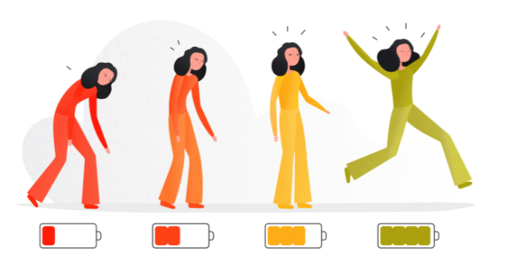
Addressing the Human Energy Crisis
Here are 6 solutions to address this crisis:
The Human Energy Crisis is the depletion of energy among
the workforce.
Put culture and purpose front and center
Make wellbeing holistic
Support career growth in meaningful ways
Focus on leader and manager capabilities
Be intentional to offer flexibility where possible
Build supportive team connections
Notes:
Timing: 6 minutes
Who: Host
Say:
There are 6 recommended solutions to address the Human Energy Crisis and help employees regenerate sustainable energy. They include the following:
Put culture and purpose front and center
Culture needs to be infused in all people processes, commitments, manager accountabilities, who you recruit, and who you reward. In today’s environment, prioritizing culture and purpose are key to fueling employee sustainability.
Make wellbeing holistic
Providing benefits and tools to help support holistic wellbeing is table stakes, as is communicating and modeling that “it is OK not to be OK” so employees are encouraged to use the resources needed.
Support career growth in meaningful ways
Ensuring employees have resources like career days, access to mentoring, and opportunities for continued skilling can provide excitement that sparks longevity and excitement for growth, and a channel to apply their passions in their careers. Employees are more energized today knowing there is a career path tomorrow.
Focus on leader and manager capabilities
Data tells us managers generate energy when they model wellbeing for themselves, coach employees to prioritize their work and set boundaries, and demonstrate that they truly care about each employee and their individual needs. And as we ask managers to infuse energy into their teams, we can’t forget managers themselves need their energy reserves topped off as well.
Be intentional to offer flexibility where possible
Autonomy and trust, when balanced with accountability, frees employees to focus on the most important metric—impact—the ultimate source of energy renewal.
Build supportive team connections
To foster a supportive team that refuels its energy supplies together, companies need to get clear on team agreements, ensure meeting inclusivity (virtually and in-person), empower authenticity, and encourage fun.

Slide 8
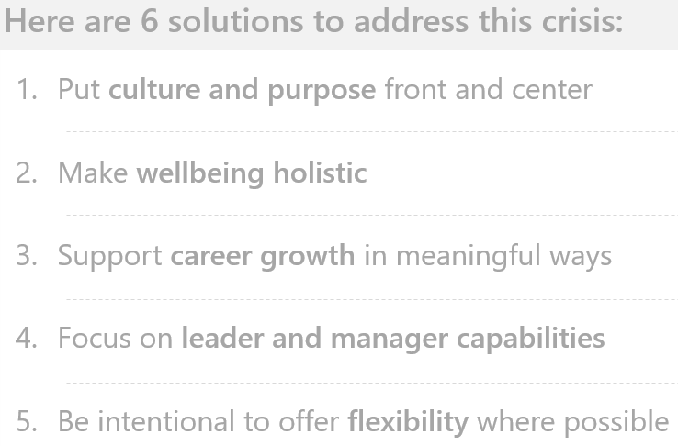
Addressing the Human Energy Crisis
The Human Energy Crisis is the depletion of energy among
the workforce.
6. Build supportive team connections
Notes:
Timing: 1 minute
Who: Host
Say:
Today is all about building supportive team connections. Building connections and supporting each other will help our collective success as an organization/team. So let’s get started!

Slide 9
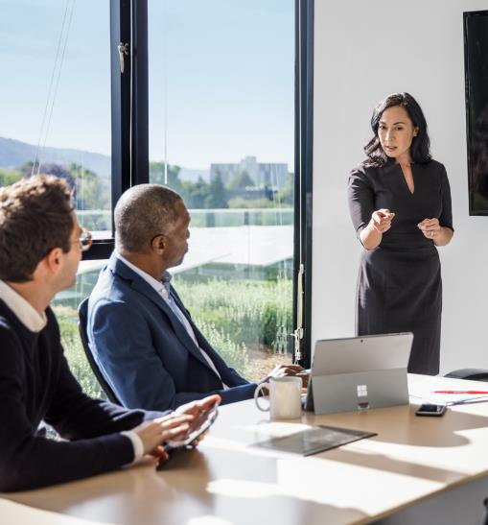
Objectives
1
A renewed sense of connection to our team/community.
2
Energy and enthusiasm to link with new team/community members.
3
An increased interest in exploring connection and relationship building in the new world of work.
A deeper understanding of where we individually and collectively are feeling energized and connected, and
where we are not.
4
Notes:
Timing: 3-5 minutes
Who: Host
Say:
As we go through the day, we hope you take every opportunity to reflect on what connection means to you and your team.
We planned today with a few objectives in mind.
After our Team Connection Day, we hope you walk away with four things: a renewed connection to our Team/Community, enthusiasm to link with a new peer, a deeper awareness of how to assess your own energy, and an appreciation for pausing as a community to explore connection and strengthen our relationships to support one another.

Slide 10



Collective agreements
Today is about YOU
Let’s experiment together
Reach out to someone new
We invite you to lean into this space created to connect.
Let’s practice active listening and a growth mindset to dive deep with one another.
Mix and mingle throughout the day, aim to meet at least one new person.
Notes:
Timing: 3-5 minutes
Who: Host
Say:
A few final housekeeping items before we move to into small group discussions.
These Collective Agreements will help make our time together a success.
Today is about you. So interact, make new connections, listen, participate in the discussions, engage in whatever way is comfortable for you.
Let's experiment together. Today will feel a bit different as it is dedicated to connection rather than specific work or deliverables. Let's practice a growth mindset and active listening to create an environment that allows us to go deep with one another.
Reach out to someone new: We don't often get to be in this shared space, so take it as an opportunity to reach out to someone new.

Slide 11
Let’s connect!
Notes:
Timing: 2 minutes (+25 minutes for activity)
Who: Host
Say:
Find 3-5 others and form a small group
Answer the following questions:
Who are you and where in the team do you work?
Reflect on a moment where you felt deeply connected. What does connection mean to you? What is it not?
Currently, where are you feeling deep connection in the workplace?
You will have 20 minutes in your small group to get through the questions
Do:
Read instructions: Ask for people to get into trios in the room and answer the questions
Leave these questions up on the screen for them to answer in trios
Keep time, at the end of 25 minutes call people back to their seats

Slide 12

Connection Activity 1: Self-reflection on connection
In small groups...
1
Introduce yourselves.
2
Reflect on a moment where you felt deeply connected. What does connection mean to you? What is it not?
Currently, where are you feeling deep connection in the workplace? Where are you craving more connection in
the workplace?
3
Notes:
Timing: 2 minutes (+25 minutes for activity)
Who: Host
Say:
Find 3-5 others and form a small group
Answer the following questions:
Who are you and where in the team do you work?
Reflect on a moment where you felt deeply connected. What does connection mean to you? What is it not?
Currently, where are you feeling deep connection in the workplace?
You will have 20 minutes in your small group to get through the questions
Do:
Leave these questions up on the screen for them to answer in small groups
Keep time, at the end of 25 minutes call people back to regroup

Slide 13
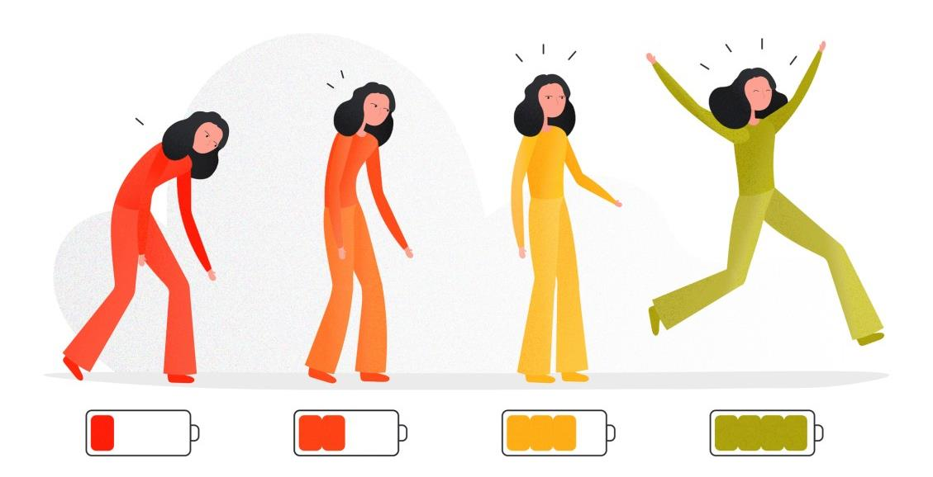
Connection Activity 2: Personal energy assessment
Low
Medium
High
Fully Charged
Notes:
Timing: 4 minutes
Who: Facilitator(s) -
Say:
Now we are going to explore human energy.
"Why Leaders Can’t Ignore the Human Energy Crisis", explains the present reality that we are beyond burnout and instead in a human energy crisis. Because the future of work depends on creating renewable human energy, we first need to acknowledge where we are sapped and where we are energized individually and collectively.
We are going to do that in the following exercise by looking at three areas linked to connection. Locating potential energy reserves and where you’re not feeling fully charged may help you manage those levels. It could also help you feel more connected to each other and the rest of the company. You will notice there are cards on your table that represent these battery charges. These will be part of the next activity, let me share what we are going to do.
Do:
Hold up cards or point to cards on the table

Slide 14
Connection Activity 2: Personal energy assessment
1
2
Individual Reflection
Discuss & Share
  Each person has 4 cards: Low, medium, high and fully charged battery images.
  You will be prompted to reflect on a specific area.
  Reflect and choose the card that best represents your current charge/energy level in that area.
  Play the card on the table face up.
  Each card is an invitation to engage. Share as much or as little as you want.
  Observe the cards that were played.
  Identify causes for the low, medium, high and fully charged cards played.
  Generate insights around our collective battery charge (energy level).
  Brainstorm one charge up idea for each area.
Notes:
NOTE: Printable energy cards are provided at the end of this deck.
Timing: 6 minutes
Who: Host
Say:
Here is how the activity will work.
Step one: Each person should have 4 cards in their possession. Do that now if you do not have them already.
Step two: I will read out an area of personal energy from the front of the room. We will go through 4 areas: Check in, Purpose, Empowerment and Well-being.
Step three: Based on the topic I read out please reflect and choose the card that best represents your current energy level in that area and place the card face up on the table for all to engage with.
Once you have placed your card we will move to the discussion at our tables.
Observe the cards that were played. What do you notice?
Identify causes for the low, medium, high and fully charged cards played. Share your stories? Why did you share the card you did?
Generate insights around our greater HR network battery charge. What do you think these cards represent as far as our greater community energy levels?
Brainstorm What is one idea you think could support charging up in that area?
Any questions?
Alright let’s try this with a simple round first. Check ins.

Slide 15
Round 1: Your Battery Charge
1
1
Introduce who you are.
Play the card (low, medium, high or full charge) that most represents your current personal battery charge.
Discuss & Share
1
Observe the cards that were played.
2
Identify causes for the low, medium, high and fully-charged cards played.
3
Generate insights around our collective battery charge.
4
Brainstorm one charge up idea for each area.
Notes:
Timing: 15 minutes
Who: Host
Say:
Here is our first topic is a check in about your overall battery charge
In this round I want you to reflect on your own personal battery charge and play the card that most represents how you feel right now. Once all cards have been placed on the table please go around and introduce yourself and why you played the card you did.
Once all introductions are complete, please:
Observe the cards that were played
Identify causes for the low, medium, high and fully charged cards played
Generate insights around our greater team network battery charge
Brainstorm one charge up idea for that area
Monitor 15-minute time – give 5 min warning

Slide 16
Round 2: Purpose
2
Play the card (low, medium, high or fully charged) that most represents your current charge around finding, living, or connecting to purpose?
Discuss & Share
1
Observe the cards that were played.
2
Identify causes for the low, medium, high and fully charged cards played.
3
Generate insights around our collective battery charge.
4
Brainstorm one charge up idea for each area.
Notes:
Timing: 15 minutes
Who: Host
Say:
Here is our second topic. Purpose.
Culture needs to offer connection to the company’s purpose, so every employee can see their work as meaningful and themselves as a mission critical component of the organization. In today’s environment, prioritizing culture and purpose are key to fueling employee sustainability.
In this round I want you to reflect on your own current charge around purpose and play the card that most represents how you feel right now.
Once all cards have been placed on the table, please:
Observe the cards that were played
Identify causes for the low, medium, high and fully charged cards played
Generate insights around our greater team network battery charge
Brainstorm one charge up idea for that area
Monitor 15-minute time – give 5 min warning

Slide 17
Round 3: Empowerment
3
Play the card (low, medium, high or fully charged) that most represents your current charge around feeling empowered to try new things, make decisions, push the boundaries and/or take risks?
Discuss & Share
1
Observe the cards that were played.
2
Identify causes for the low, medium, high and fully charged
cards played.
3
Generate insights around our collective battery charge.
4
Brainstorm one charge up idea for each area.
Notes:
Timing: 15 minutes
Who: Host
Say:
Here is our third topic. Empowerment.
Creating a culture where employees feel empowered, included, and autonomous—among other attributes—is crucial.
In this round I want you to reflect on your own current charge around empowerment and play the card that most represents how you feel right now.
Once all cards have been placed on the table, please:
Observe the cards that were played
Identify causes for the low, medium, high and fully charged cards played
Generate insights around our greater team network battery charge
Brainstorm one charge up idea for that area
Monitor 15-minute time – give 5 min warning

Slide 18
Round 4: Wellbeing
4
Play the card (low, medium, high or fully charged) that most represents your current charge around your personal and/or professional wellbeing?
Discuss & Share
1
Observe the cards that were played.
2
Identify causes for the low, medium, high and fully charged
cards played.
3
Generate insights around our collective battery charge.
4
Brainstorm one charge up idea for each area.
Notes:
Timing: 15 minutes
Who: Host
Say:
Here is our fourth topic. Wellbeing.
It is clear that external impacts are taking a toll on employee wellbeing. We’re facing a mental health crisis and it can be hard to navigate how and where to get help in a complicated system. What we do know is that well being generates energy and we need to address it holistically
In this round I want you to reflect on your own current charge around well being and play the card that most represents how you feel right now.
Once all cards have been placed on the table, please:
Observe the cards that were played
Identify causes for the low, medium, high and fully charged cards played
Generate insights around our greater HR network battery charge
Brainstorm one charge up idea for that area
Do:
Monitor 15-minute time – give 5 min warning

Slide 19
Host reflections
Host Reflections
Name
Title
Notes:
Timing: 2-5 minutes
Who: Host (Hosts have been briefed with talking points)
Say:
Thank you, [name].
I’m so grateful you all chose to be here today. As I went through the activities, I noticed a few themes pop up again and again. [List themes]
They helped me to think deeply about how I connect with myself and others. For example, [Share how one or two conversations changed, enhanced, or affirmed your thinking on Connection].
After today, I trust we have the energy to collectively [Share how you want the team to carry forward the day].
I will do the same by [Share how you will carry forward the day].
Again, thank you for being present, attentive, and vulnerable today.

Slide 20
Thank you!

Slide 21
Resource
Resource
Energy cards as referenced on slide 14
You may print the following card sets for use in the team exercise

Slide 22


Fully charged battery
Fully Charged
Fully Charged
Fully Charged
Fully Charged

Slide 23

High energy charged battery
High
High
High
High

Slide 24

Medium energy charged battery
Medium
Medium
Medium
Medium

Slide 25

Low energy charged battery
Low
Low
Low
Low

