Slide 1
4th QUARTER SOLUTIONS
Microsoft Dynamics 365 Business Central for
Food Processors and Distributors
Microsoft Dynamics 365 BC
Software & Service Provider

Slide 2
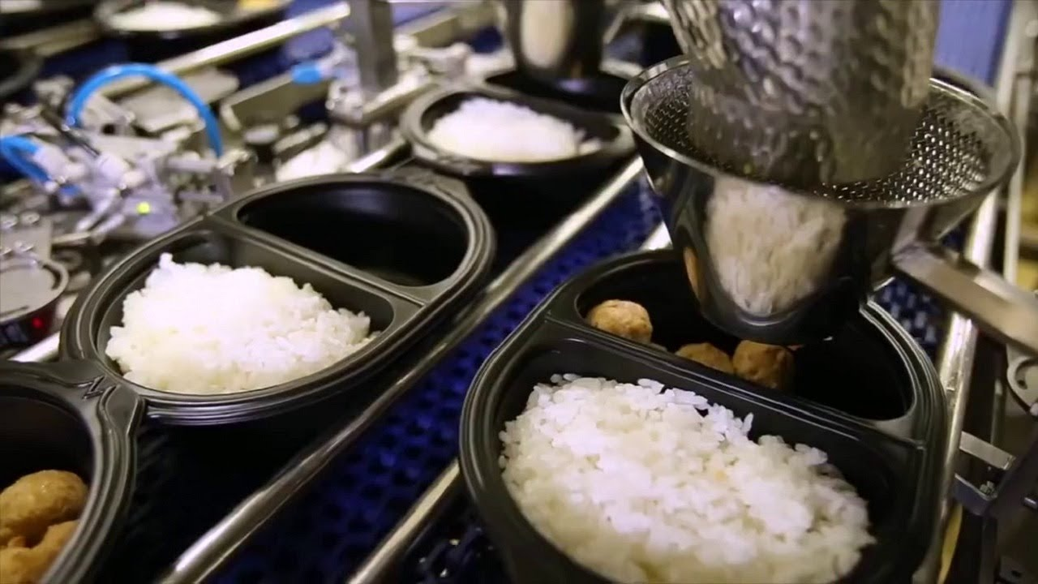
D365 BC for Food Processors and Distributors
Agenda
Introduction to Dynamics 365 BC and 4th Quarter Solutions
Highlights of D365 BC capabilities for Food Companies
Processing Capabilities
Warehouse and Distribution Capabilities
Demonstration of D365 Business Processes
Review of your top requirements
Next Steps

