Slide 1
I
C
E
Intertec Cloud Experience
Hybrid IT
Managed Service
Provider

Slide 2
About Intertec
27 Years; Middle East & India
Regional Specialist; Top 10 in the GCC
Employee Retention > 90%
24/7 integrated NOC
5 Software IP’s & ODC
30+ Technology Alliances
Long Term Partnerships
Compliances
Regional Specialist
Manama
Dubai
Muscat
Mumbai
Riyadh
Abu Dhabi
Bangalore

Slide 3
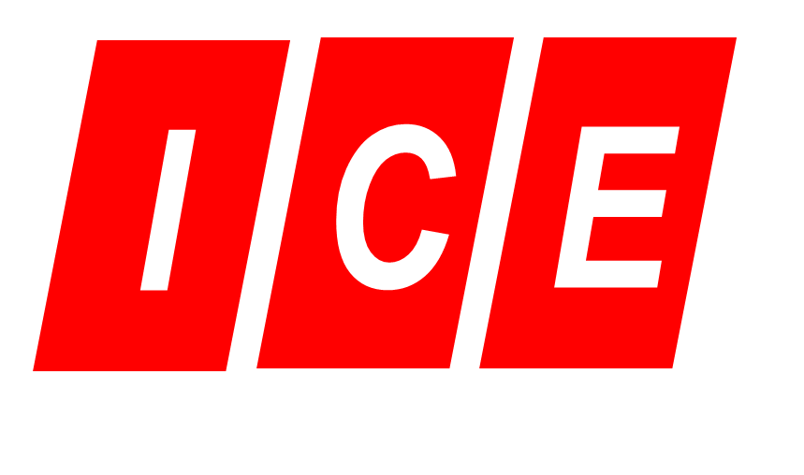
ICE in a Block
Cloud Services
End Point Security
End Point Backup
Device and App Management
Backup as a Service
DR as a Service
App Cloud
DevOps Architecture
Private Cloud
Hybrid Orchestration
Public Cloud
Containerization
Data Lake
Content Management
Big Data Architecture
App Automation
Cloud Marketplace
Cloud Solutions and Catalogues
Cloud Expense Management
Inventory and Classification
Provisioning Services
Role Based Access
Validation
GOVT.
INSURANCE
BANKING
RETAIL
ENTERPRISES
Cloud Adoption Advisors
Cloud Managed Services
Migration Services
Multi Cloud Architecture Support
IaaS Services Support
Monitoring and Analytics
Cloud Native Service Mgmt
Continuous Integration
Data Base Management
Hybrid Cloud Providers
Open Source Advocates
Data Monetization Strategists

Slide 4
Intertec Cloud Experience : One IT Managed Services
Simple Services
Device management
User Management
Team Collaboration
BaaS and DRaaS
Hybrid IT Services
Cloud Migration
Managed DevOps
Hybrid Orchestration
Private Optimization
Identify
Advise
Support
Execute
Manage
Cloud Advisory
Futuristic Services
Big data Analytics
Data Visualization
Block chain
AI & Machine learning
High Impact Services
Hybrid data Lake
Containerization
Enterprise Content Management
HDFS/ Big Data Ingestion
Platform
$
One Bill
One Support
Self Service
Control
Automation
IaaS
Hybrid Cloud
BaaS
DRaaS
Hybrid Data Lake
Adoption
Service Catalogues
SaaS Demo
Strategy
Solutions
PaaS
DevOps
Containers
Open Source
3rd Party Validation

Slide 5
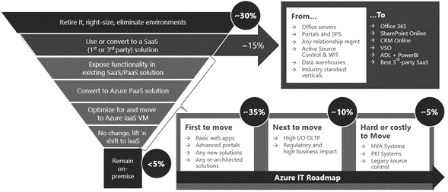
Microsoft Cloud Adoption Framework

Slide 6
ICE IaaS + PaaS Advisory (Step 5)
Why?
Not all legacy Services are built for the cloud
Movement of cloud depends completely on resource consumption
Network bandwidth plays a crucial role as there are large cost implications
How it Helps?
Have visibility on how efficient is the actual provisioning of VMs
Have a chance to create Digital experience on Elastic Compute
Improve financial efficiency
Why ICE?
Free engagement for existing customer of ICE
Create a centralized application strategy that consumes resources effectively.
We believe Cloud is only hybrid where in the percentages of Public or Private cloud can be as low as 1% but that percentage is going to be tailored for each account.
Supported By

Slide 7
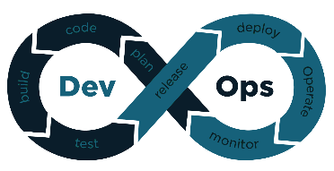
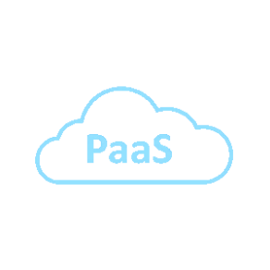
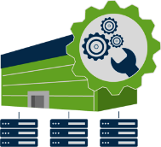
Step 1 : Identify : Concept
All Users
App 3
App 4
App 1
App 2
App 3
App 4
Virtualization
Hybrid Orchestration
Analysis
App 1
App 2
Data Center
Managed Collocation or Regional Service providers
Current Eco system
Migration and Optimization

Slide 8
Step 1 : Identify : Categories
Category : App 1
Used by Internal Users more than 80% of the time. Ex: ERP, Billing etc
Has less than 20% Flexibility on Resources Utilization
Hosted on Private Cloud Architecture
Provides Integration to external Apps only via Secure network access or APIs
Category : App 2
Used by External Employees or Systems more than 80% of the time. Ex – CRM, Logistics
Has less than 20% Flexibility on Resources Utilization
Hosted on Local Collocation/ providers or regional public cloud stacks
Collect Data from Applications using secure VPN while saving costs on Pseudo Flexibility.
Category : App 3
Used by Customers for applications that require simple change of user interface and change to web based/ Session based service delivery. Ex Overhaul basic web portals into simple app Services.
Has more than 20% Flexibility on Resources Utilization
On Public Elastic Cloud
Take Advantage of Elastic On Demand growth and maintain high efficiency
Requires DevOps for changing Apps to Session Based Web User Interfaces
Category : App 4
Used for PaaS Architecture which requires continuous Integration : Mobile apps, Digital Marketing engines, Payment Gateways, E Services etc
Has more than 20% Flexibility on Resources Utilization
On Public Elastic Cloud
Take Advantage of Open source eco-system and Containerization to re-architecture complete applications to build futuristic services.
Requires DevOps with Continuous Software delivery motion and continuous integration
Common Goal : Maintain at least 80% efficiency on resource Utilization

Slide 9
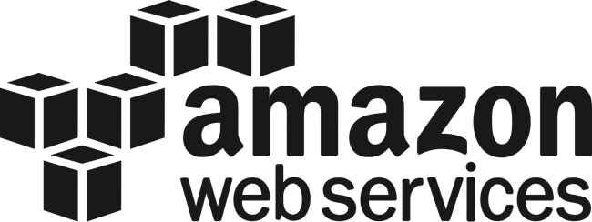
Lift and Shift with App-Cloud (Step6)
Why?
Post Advisory, these services are easiest to be moved to cloud as they fit the roles perfectly.
Immediately free up resources of on-prem infrastructure
Improve architecture utilization for Customer facing applications
How it Helps?
Reduce Capex Investments
Increase the cost efficiency
Adopt more technology
Create high availability and SLA’s for simplified applications
Why ICE?
In-depth understanding of cloud native services
Architecture support
Financial management of Subscriptions to maintain costs
Supported By

