Slide 1
GISV project
Dynamics 365

Slide 2
Enavate Team Introductions
Enavate Development Methodology
Technical Assessment
Assessment Review and Next Steps

Slide 3
Enavate Team Introductions

Slide 4
Team Members
Pavel Tseranidzi, PMP, Sr. Manager,
  Project manager role on the project, over 10 years experience in Dynamics area.
Alexander Bashmakov, Sr. Software Development Engineer
  Lead developer role on the project, over 10 years experience in Dynamics from v3.0 through AX 2012, and Dynamics 365
Tatiana Cherniavskaya, Software Development Engineer
  Developer role on the project, over 10 years experience in Dynamics from v3.0 through AX 2012, and Dynamics 365
Executive Sponsor
Enavate Steering Committee
Enavate Program Lead
Project Manager
Development Team

Slide 5
Enavate Development methodology
GISV implementation

Slide 6
Using Scrum methodology on projects:
- How Scrum works on projects
People, Planning, Process, Performance, Profit

Slide 7
Purpose And Approach
From experience SCRUM is a more efficient way to deliver GISV projects such as for…
PROS
  Less management time
  Close team interaction, high motivation
  Continuous self-improvement
  Organized customer involvement, transparent in progress tracing
  Deliverable product anytime, more flexible to changes

Slide 8
Project

Slide 9
Phase

Slide 10
Sprint

Slide 11
Proposed Infrastructure

Slide 12
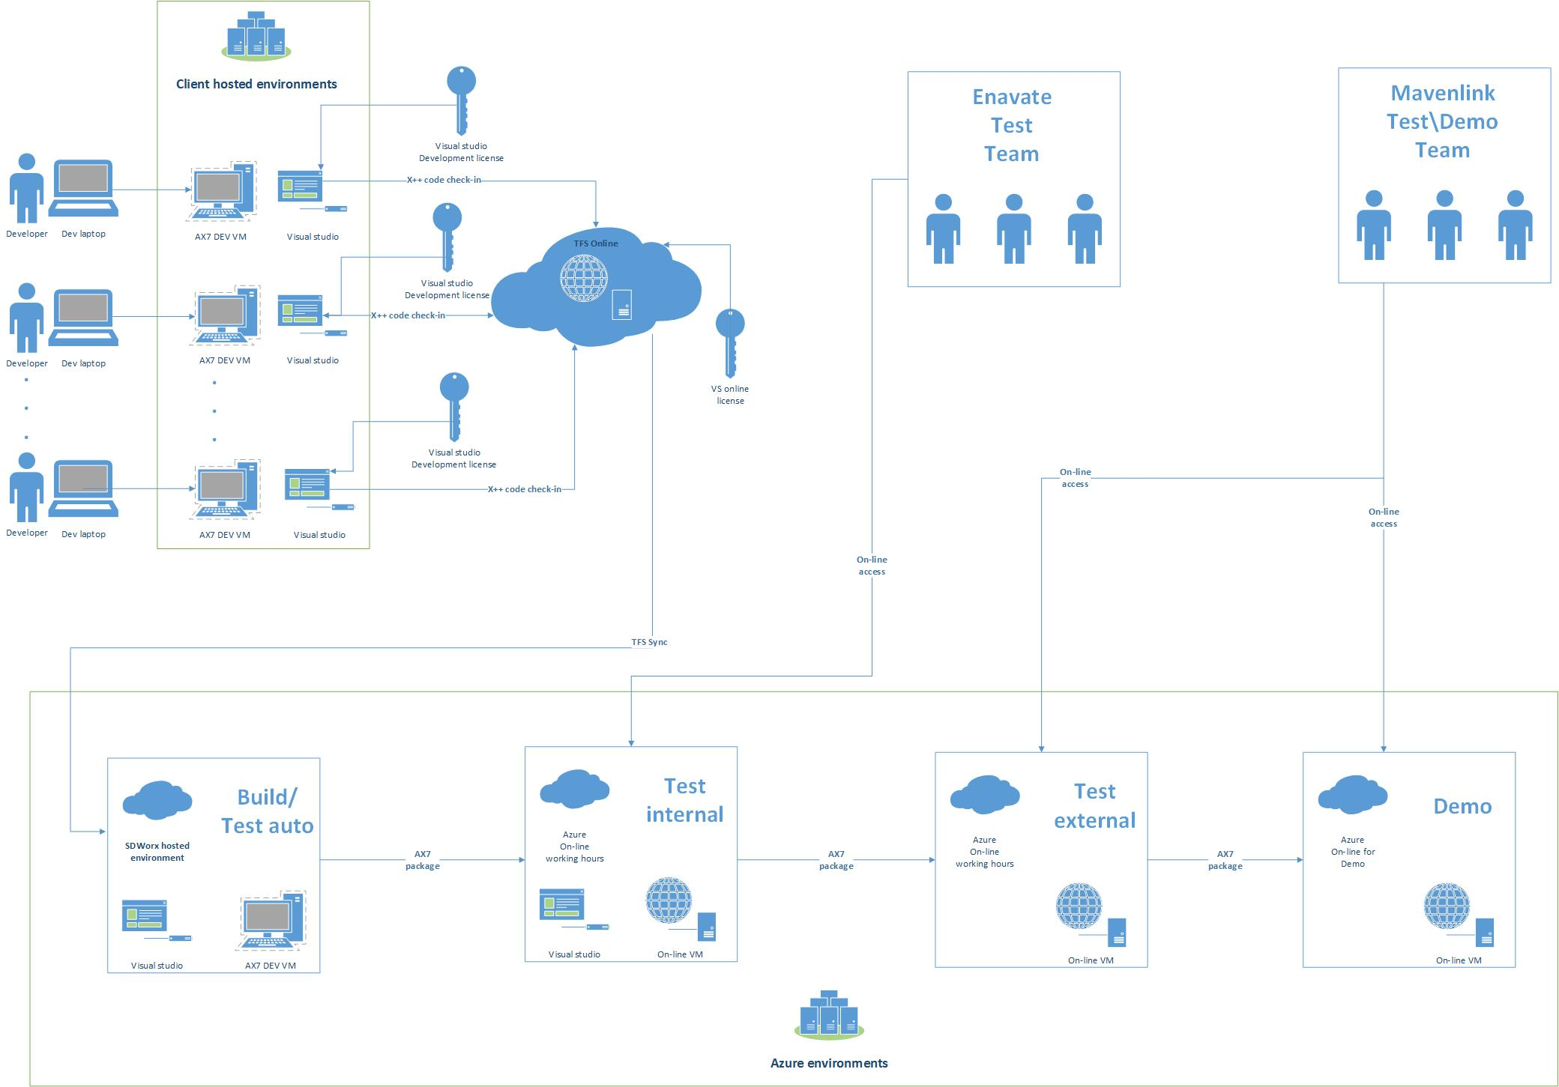
Typical Infrastructure Architecture

Slide 13
Licensing / Infrastructure Preparation
Visual Studio Licenses- Normally we use customers
  Microsoft Test Manager
VSTS – Visual Studio Team Services – Normally we use customers
Azure subscription
Define development machines – Local or Virtual machines (typically use customers VM)

Slide 14
Engagement Checklist

Slide 15
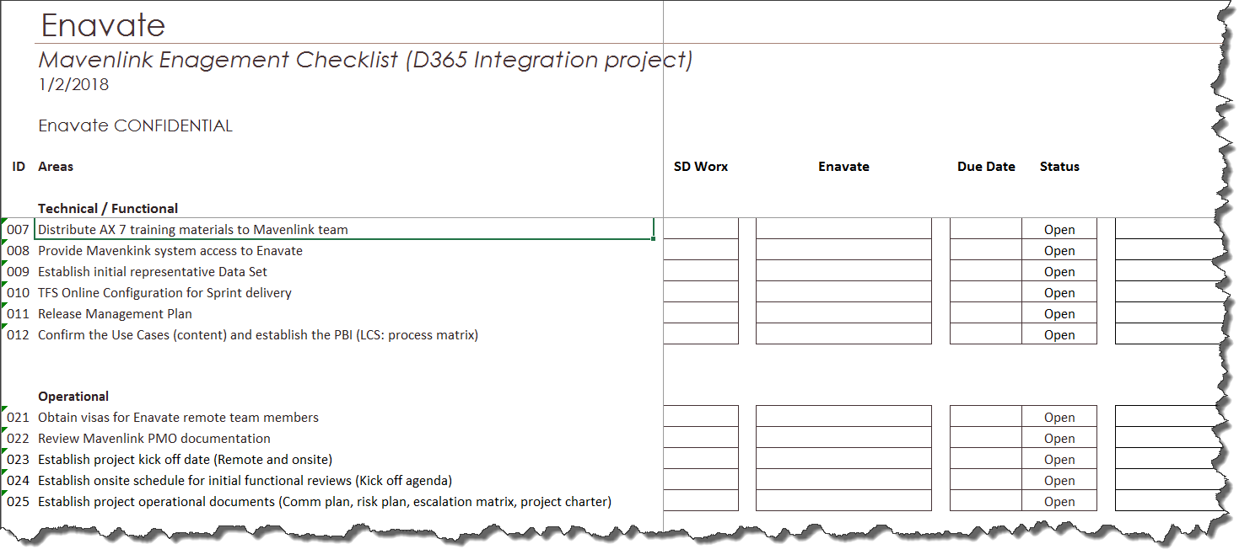
Engagement Checklist

Slide 16
Scope Discussion

Slide 17
High Level Scope Discussion
Scope Discussion – input form client side, help from Enavate side.

Slide 18
Q&A
Next Steps

Slide 19
Next steps
Plan Knowledge Transfer Workshop
Define Scope
Create Project Plan
Coordinate document sharing
Decide on meeting cadence
Engagement Checklist

