Slide 1
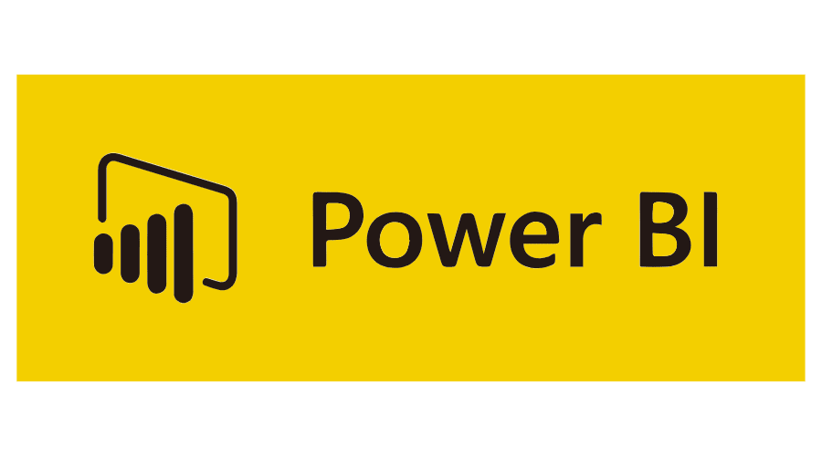
Dynamics 365 Customer Engagement/CRM: What we do
We help our clients grow by enabling them to understand their prospects and clients, streamlining sales, marketing, customer service, and operations, putting data at their fingertips, and creating engaging customer experiences.
Customer Engagement | Sales | Service | Marketing
Project Service Automation | Field Service Administration
We’ve helped hundreds of companies use Dynamics 365 to grow and succeed
including some who are making the world a better place (Team Rubicon 3 min video)

