Slide 1
DO YOU FEEL STUCK WITH YOUR OUTDATED INFOR CRM (SALESLOGIX)?
INFOR MIGRATION TOOL

Slide 2
COMMON PAIN POINTS WITH INFOR CRM
Limited functionality
Dated user interface, slow speeds
Limited to one screen, can’t have multiple windows / accounts open
Must use third-party vendor to make custom configurations: layout, reports, etc.
Manual, fee-based updates
Must pay to upgrade to each new version
Upgrades may cause compatibility issues with other systems
Difficult, time and resource-intensive to upgrade

Slide 3
SOLVE THROUGH OUR UNIQUE INFOR MIGRATION TOOL
Our team can migrate your data from Infor CRM (Saleslogix) to Microsoft Dynamics 365 for less than the cost of upgrading to the latest Infor CRM version.
Minimize costly manual labor
We’ve pre-mapped all out-of-box fields in both systems to cut migration time in half
Avoid data loss during migration
We can also match and create new, custom fields to ensure all data gets moved accurately
Customize to your process needs
We’ll collaborate with you to clean up old data, configure functionality improvements, and design automated workflows to fit your business process

Slide 4
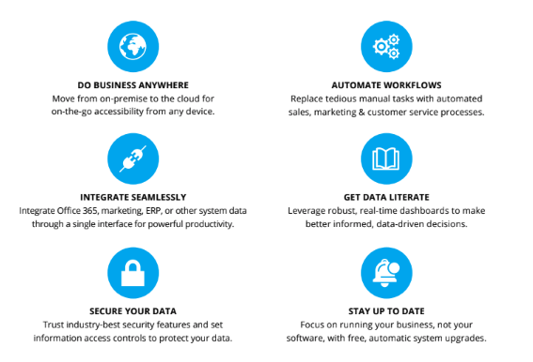
SOLVE THROUGH OUR UNIQUE INFOR MIGRATION TOOL
Eliminate Infor CRM (Saleslogix) pains and do more with Microsoft Dynamics 365, the leading solution for salesforce automation, marketing and customer service.

Slide 5
INTERESTED? TRY A 30-DAY FREE TRIAL
Migrate up to 10,000 of your business accounts and contacts from
Infor CRM to Microsoft Dynamics 365 – at no cost or obligation.
888.719.0248
sales@trellispoint.com

