Slide 1
Technology Consulting Education Series
Collaboration/CRM
Enabling growth, efficiency, and engaging customer experiences for our clients

Slide 2
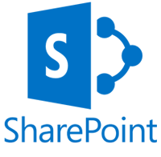
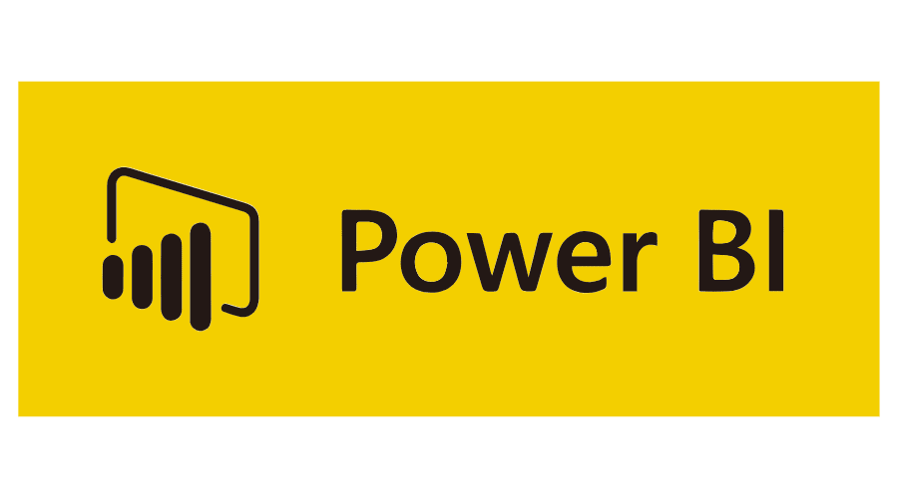
What we do
We help our clients grow by enabling them to understand their prospects and clients, streamlining sales, marketing, customer service, and operations, putting data at their fingertips, and creating engaging customer experiences.
Customer Engagement | Sales | Service | Marketing
Project Service Automation | Field Service Administration

Slide 3
Who we help
Companies that have customers.
Notes:
Channel Shifting – New forester data indicates that 75% of B2B buyers prefer to buy online, yet 25% of B2B companies sale online
Cutting Cost – According to Forester, B2B companies can slash the cost to service a customer by as high as 90%. Some 56% of customers are online profitable if serviced online
Far reaching competition – Customer experience and value add tools / services provide defense against competition
Improvement in supply chain performance – average profit margins and supply chain performance stubbornly flat

Slide 4
How do we help clients? Some stories:
Manufacturing and Distribution
Construction
The Company
Multi-faceted distributor and servicer of electric motors; manufacturer of controls for dams.
The Need
Needed to gain efficiencies within inside sales, manage outside sales rep activity, and capitalize on cross sell opportunities between business units.
The Solution
Using Microsoft Dynamics 365/CRM, we created a system that greatly reduced the number of clicks required to generate and e-mail a quote, consolidated multiple sources of client information, and implemented an e-mail marketing platform that enabled L&S to create e-mail nurture campaigns and rive additional revenue.
The Company
Manufacturer and distributor of atomic clocks and weather stations.
The Need
Manage the complex call center workloads of an extensive seasonal product line sold via eCommerce direct and through big box retailers, and track customer touchpoints across digital channels.
The Solution
Implemented Dynamics 365 in the Call Center to handle high volume seasonal calls coming in, tiered/expert based support, knowledge base, FAQ’s, Product Registrations and Warranty work, including integration with the company website to create a seamless customer experience.
The Company
Mid-size general contractor specializing in interiors.
The Need
As part of ECI’s 5-year strategic plan, they identified the need to create a sales culture, streamline pursuits, understand their complex relationships network, and improve forecasting.
The Solution
Using Wipfli Connect for Construction, a Dynamics 365/CRM platform, integrated with Viewpoint, we created a system that enables all associates to capture and be credited with leads, memorialize their networks, and efficiently manage project resource schedules.
The Company
Leading rail construction and maintenance company.
The Need
Holland had a very old system that managed nearly every aspect of their construction division’s operations. This needed to be replaced to reduce operational risk, improve scheduling, and become more efficient.
The Solution
Created a new operating system based on Dynamics 365 that managed relationships, deal flow, contracts, forecasting, resource needs planning, and crew and resource alignment.
Notes:
Holland: Produce the vehicles that service the train tracks, and then contracting to service and repair these solutions. Heavy power BI. The only thing Dynamics doesn’t (doesn't use Finance & Ops – instead it’s IFS).
ECI: They’re trying to build the culture of business development (part of the 5 year strategic statement – then they realized they needed more than technology – now they think every company needs and should have – now they can get the information at the tips of their figure to … so they need to build the developer that they will do that – developers are bleeding cash.
Team Rubicon
Wildly ambitious with the impact they are going to make on the community they are engaged in. So they want to make sure they grow their engaged volunteer base. They want to build awareness of these causes – make the most impact they make with that money, but grow the whole thing. It started as an international thing.
They are using the D365 platform, Azure, Power BI, and now AI, to drive those KPIs (the biggest: # of engagement members, aggregated level of engagement of those members (AI is going to be making decisions about if/then scenarios). The key is measuring: The make sure that is driving stronger impact to the communities, then earlier makes sure they are serving the right communities – so focus on the communities are that are in way more need. They look at both who they are helping, We are helping them build WAY better teams – some things – good organization solves problems…

Slide 5
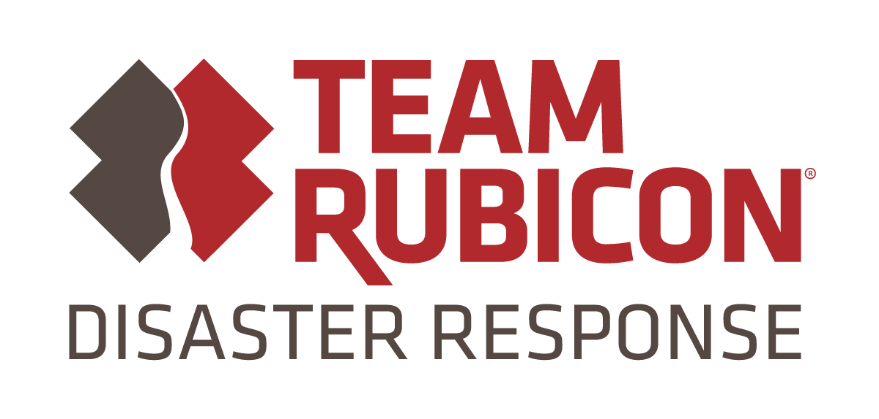
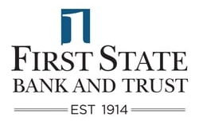
How do we help clients? Some stories:
Non Profits
Financial Institutions
The Organization
Community Action Partnership of Kern is the largest CAP in the nation.
The Need
CAPK offers multiple programs and service offerings for their client base, but does not have a centralized way to track, engage, and report on an individual. There is a large need for centralized intake and reporting to be able to effectively serve and report on the community as a whole.
The Solution
A framework centered around Dynamics 365, Azure Data architecture, and Power BI to managed client data through centralized intake and integrate it with their core systems to see all programs and services they are participating in and pull other eligible offerings.
The Organization
Volunteer-based emergency response organization.
The Need
Reduce the time –to-deploy following an emergency and deploy the most effective team to match the need. Ultimately they want to create the most engaging experience possible for their volunteers.
The Solution
Using Dynamics 365, Azure, Power BI, and soon Artificial Intelligence, we created an integrated system that allows for incredibly fast team building, optimal targeting of volunteers based on driving distance, skillset, and volunteer experience, and designed an experience that is getting rave reviews from volunteers, Team Rubicon, and Microsoft alike.
The Company
Independent community bank providing personal and business banking, insurance and wealth management across 7 branches.
The Need
Continue to grow the bottom line without losing their reputation of providing personalized service and without expanding their footprint.
The Solution
Utilizing Wipfli Connect for Banking, a Dynamics 365-based platform, we created one view of their clients across 3 core banking systems, created mechanism to automatically “score” their clients, and a referral management process that allows ease of referral creation and visibility to executives.
The Company
A publicly traded national bank with $3 billion+ under management.
The Need
Nicolet was in heavy growth mode and needed a more effective way to view customer data, track opportunities, referrals, and monitor applications and loan statuses in one place.
The Solution
Built upon Salesforce.com, Wipfli designed a customer relationship solution that integrated with their core processing system and served that information up into an easy to access and update interface, streamlining sales and operations. This platform continues to evolve with the bank as it grows.
Notes:
Holland: Produce the vehicles that service the train tracks, and then contracting to service and repair these solutions. Heavy power BI. The only thing Dynamics doesn’t (doesn't use Finance & Ops – instead it’s IFS).
ECI: They’re trying to build the culture of business development (part of the 5 year strategic statement – then they realized they needed more than technology – now they think every company needs and should have – now they can get the information at the tips of their figure to … so they need to build the developer that they will do that – developers are bleeding cash.
Team Rubicon
Wildly ambitious with the impact they are going to make on the community they are engaged in. So they want to make sure they grow their engaged volunteer base. They want to build awareness of these causes – make the most impact they make with that money, but grow the whole thing. It started as an international thing.
They are using the D365 platform, Azure, Power BI, and now AI, to drive those KPIs (the biggest: # of engagement members, aggregated level of engagement of those members (AI is going to be making decisions about if/then scenarios). The key is measuring: The make sure that is driving stronger impact to the communities, then earlier makes sure they are serving the right communities – so focus on the communities are that are in way more need. They look at both who they are helping, We are helping them build WAY better teams – some things – good organization solves problems…

Slide 6
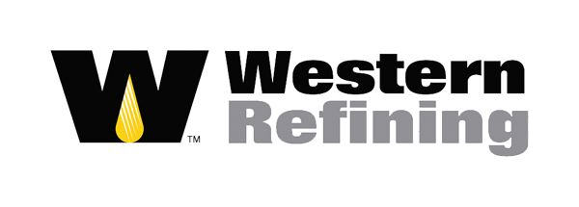
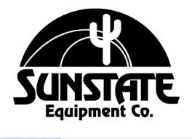
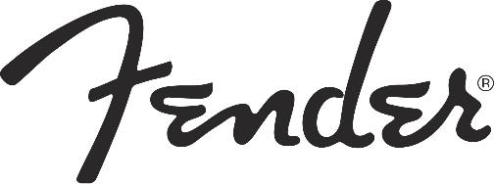
How do we help clients? Some stories:

Slide 7
Why you should care about Collaboration/ CRM systems
The average return on investment for CRM is $8.71 for every dollar spent. (Nucleus Research)
Effective sales organizations are 81% more likely to be practicing consistent usage of a CRM or other system of record. (Aberdeen Group)
The average CRM user adoption among sales professionals is 73% and the average ROI period is 13 months. (G2’s CRM Software Research)
CRM applications can help increase sales by up to 29%, sales productivity by up to 34% and sales forecast accuracy by 42% (Salesforce)
74% of users said their CRM system gave them improved access to customer data (Software Advice) and data accessibility for salespeople shortens their sales cycles by 8-14% (Nucleus Research)
47% of polled CRM users said that their CRM had a significant impact on customer retention, and an equal percentage said their CRM had a significant impact on customer satisfaction. (Capterra)
Notes:
How does one achieve a positive ROI?
* Some basics – reduced time looking up information

Slide 8
Questions to ask
Do you know who your best customers are? Are you taking care of them?
Does your sales team have the tools to be armed with the knowledge to position the right product at the right time? Can they access customer data from their mobile devices?
Do you have more than one “source of truth” of who your clients and prospects are?
Do you know what sales to expect next quarter?
Do you believe your customers have a positive experience working with your organization? How do they engage with you digitally?
Do you have a digital marketing strategy, and if so, is it effective?
Are your executives and sales leadership aligned on a growth strategy?
Are you keying in the same information into multiple systems?
Are you using spreadsheets to track leads, opportunities, or anything related to prospects or customers? If no, what system are you using to track that information and is the vendor/partner providing valuable guidance?

Slide 9
Technology Consulting Education Series
Collaboration/CRM
Enabling growth, efficiency, and engaging customer experiences for our clients

