Slide 1
App Modernization & Migration to Azure 10-Day Workshop
10+
1200+
20+
2500+
Time Microsoft Gold Partner
Satisfied Customers
Years in Business
Successful Engagements

Slide 2
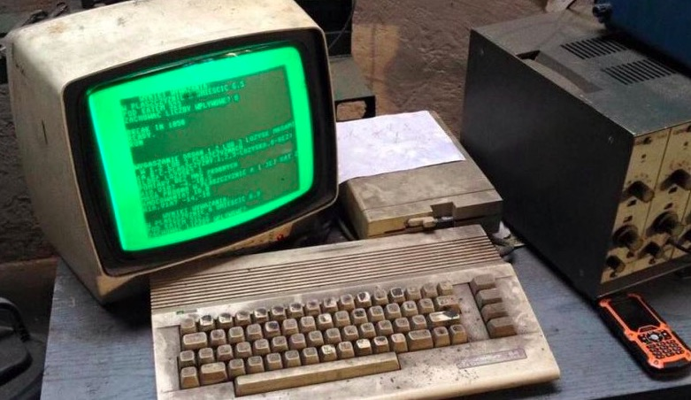
Application Evolve. Are You Evolving?
Applications evolve over time. Just like businesses, an application must be evaluated,
changed, and possibly be reinvented to take advantage of innovative business practices,
new technologies, or to change the operational costs of using the application.
Are your legacy applications holding your business back?
The introduction of new application environments such as Microsoft Azure offer new cloud platform alternatives upon which to modernize and migrate legacy applications.

Slide 3
Imaginet’s App Modernization & Migration Workshop
Modernized Applications. Powered by Azure.
With Imaginet’s 10-Day App Modernization and Migration to Azure Workshop, our Azure
Professionals will accelerate your Application Modernization and Migration efforts, while at
the same time, adding in the robustness and scalability of cloud technologies. Our deep
technical skills and expertise with Microsoft Azure enables your organization to develop
software applications that add functionality, scale dynamically, and cost you less to build
and run over their lifetime.
Save Money
by Eliminating Hardware Costs
Dynamically Scale
to Support Changing Needs
Save Time
needed to procure/maintain hardware
Improve Focus
on delivering business value

Slide 4
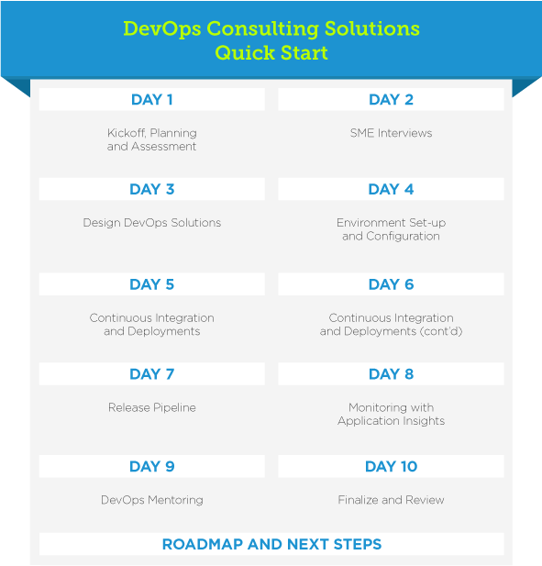
How It Works & What Is Included
Application Assessment
App Modernization & Migration
10-Day Workshop
Imaginet will lead an evaluation of the business problem solved by an application, what organizations and individuals are affected by the application, infrastructure dependencies, total cost of ownership (TCO), and possible modern architectures that could be applied to the application. As part of the assessment Imaginet will utilize our Cloud Decision Framework to ensure that the legacy application is well suited to Azure.
Kickoff, Workshop Planning
Application Assessment
Technical Architecture
Assessment
Azure Environment Setup & Configuration
Application Pilot in Azure
Imaginet will configure the Azure environment for your selected Pilot Application and connect it to your organization’s on premises network. Application changes/code rewrites are performed to allow the application to meet all current business requirement and architected to run within Azure.
POC: Application
Architecture Changes
POC: Application
Code Changes
POC: Application
Code Changes
POC: Application
Deployment & Testing
Roadmap & Next Steps
POC: Application
Final Testing
Finalize & Review
Once the pilot is complete, Imaginet will provide a roadmap and next steps to migrate and modernize your entire application(s).

Slide 5
Why Imaginet?
When you’re ready to modernize and migrate your legacy apps to Azure, you never want to do it alone.
This is where the Imaginet's Azure & Application experts come in.
Imaginet has helped over 1200 customers around the globe with all of their application and software needs—and we’re ready to help you, too.
.

Slide 6
Customer Success Stories
Imaginet is the easiest and most
knowledgeable technical partner to work
with. They spend time to understand your
business and help you implement the best
solution for your customers. You can’t find an
agency that is more responsive or provides
more quality information than Imaginet.
ALI ISHAM, Marketing Director, Overhead Door Corporation
From the five engagements that we have
done with Imaginet so far, we've been
really, really happy with each one of them.
Imaginet is a really good company to work
with, and their reputation speaks for itself.
MICHEL THIVIERGE, Director of Application Architecture, DataScan Holdings

Slide 7
Innovation. Expressed.
www.imaginet.com | 1-800-989-6022

