Slide 1
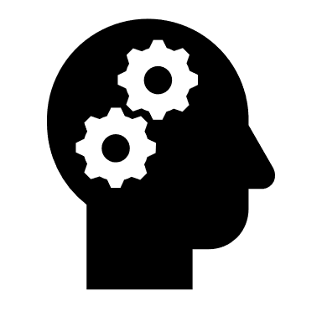
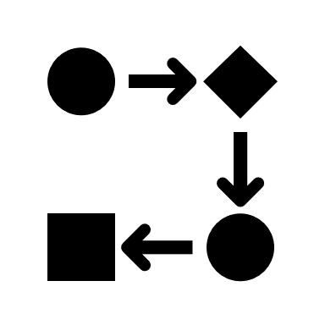
Co-Develop an Analytics Solution with Microsoft Azure and the Power Platform that empowers users and rapidly delivers value.
MICROSOFT AZURE SOLUTION BUILDER PROFILE: Beyond Impact
Beyond Impact is a Microsoft Gold Partner focused on building end-to-end Data Platform and Business Analytics solutions for clients utilizing Microsoft Azure and Power Platform (Power BI, PowerApps and Flow). Our secure and scalable solutions give clients a competitive edge by helping organizations visualize their data faster propelling insight into a calculated action.
WHAT WE OFFER
TRAIN
CREATE
IMPLEMENT
EMPOWER
Beyond Impact provides tailored training for Power BI, PowerApps and Flow. This offers clients the ability to start building their skills quickly and provides them access to a qualified data consultant. We have found that this approach builds backing for a strong analytics practice and helps ensure stakeholder advocacy.
Our systematic and collaborative approach to development allows for a rapid deployment of the solution. We work with your subject area experts and power users to build on the Power Platform with Microsoft Azure. Our agile development process ensures we are prioritizing the work and delivering the right functionality.
At Beyond Impact, we take full responsibility for every solution we help create. Not only do we deliver unique, customized solutions – we follow our work closely every step of the way. We support you throughout the process to resolve key issues, ensure relevant testing and deliver production-ready solutions.
A key feature of our Co-Development process is that we put the client in the driver’s seat. We aim to deliver a solution that the client can own, operate and enhance. While many consulting firms try to maintain control over the solution, Beyond Impact empowers our clients. This differentiator is a hallmark of our service.
WHAT OUR CUSTOMERS ARE SAYING
“Our engagement with Beyond Impact was highly successful on two fronts: our team got both training and hands-on experience working with Power BI, and we were able to co-develop a real-world solution. – Joe Pike, CTO, Barlow Research
LEARN MORE
Find out how you can benefit from Co-Development with Beyond Impact by contacting us at sales@beyondimpactllc.com.
© 2019 Beyond Impact
Go-To-Market Services

Slide 2
Microsoft Azure
Microsoft Azure is an open and flexible cloud platform that enables you to quickly build, deploy, scale, and manage applications across a global network of Microsoft data centers. You can build applications using multiple languages, tools, and frameworks.
KEY USE CASES
WEB APPLICATIONS
Build anything from lightweight websites to multi-tier cloud services that scale up as your traffic grows.
CLOUD STORAGE
Rely on geo-redundant cloud storage for backup, archiving, and disaster recovery.
BIG DATA & HPC
Get actionable insights from your data by taking advantage of a fully compatible, enterprise-ready Hadoop service.
MOBILE
Accelerate your mobile app development by using a backend hosted on Microsoft Azure. Scale instantly as your install base grows.
MEDIA
Create, manage, and distribute media in the cloud – everything from encoding to content protection to streaming and analytics support.
FLEXIBLE APPLICATION MODEL
Microsoft Azure provides a rich set of application services, including SDKs, caching, messaging, and identity. You can write applications in .NET, PHP, Java, node.js, Python, Ruby, or using open REST protocols. This is all part of Microsoft’s promise to let you build using any language, tool, or framework.
ALWAYS ON, ALWAYS HERE
Build resilient applications with automatic operating system and service updating, built-in network load balancing, and geo-redundant storage. Microsoft Azure also proudly delivers a 99.95% monthly SLA. You can rely on decades of experience in data center operations and trust that everything Microsoft Azure offers is backed by industry certifications for security and compliance.
DATA CENTER WITHOUT BOUNDARIES
Microsoft Azure makes it easy for you to integrate your on-premises IT environment with the public cloud. Migrate your virtual machines to Microsoft Azure without the need to convert them to a different format. Use the robust messaging and networking capabilities in Microsoft Azure to deliver hybrid solutions, and then manage your hybrid applications from a single console with Microsoft System Center.
GLOBAL REACH
With data centers around the globe, a massive investment in data center innovation, and a worldwide Content Delivery Network, you can build applications that provide the best experience for users, wherever they are.
Learn more: www.microsoftazure.com
© 2019 Microsoft Corporation. All rights reserved.

