Slide 1
Itergy IT Test/Dev Environment Hosted in the Cloud
Microsoft Azure
Notes:
To be completed by: Sales Exec

Slide 2
On-Premises Test/Dev Environment Challenges
On-premises test/dev environments require a significant investment of time and resources to acquire, set up, maintain and eventually replace the hardware.
Your organisation might be challenged with creating realistic scale tests. Often the costs are disproportionately high compared with the low utilization of the infrastructure.
Many companies working with budget and capacity limitations struggle to set up test/dev environments.
What if you could implement this environment faster, reduce your overall cost significantly and never have to worry about hardware provisioning and installation?

Slide 3
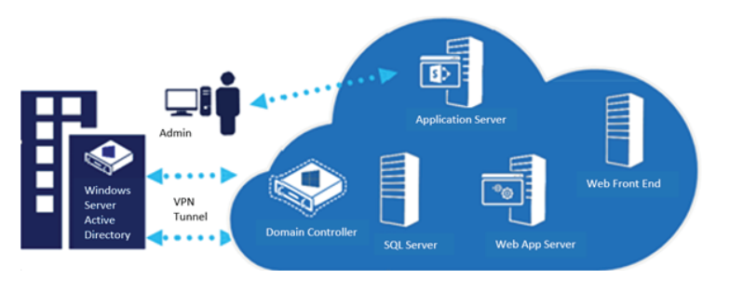
Itergy’s Solution
As a Microsoft Gold Certified Partner, Itergy can provide you with a complete solution to help you achieve your goals.
We'll put your test/dev environment in the cloud, thereby eliminating the need to acquire permanent resources and providing you with a pay-per-usage model.
Our solution includes:
• Five-day on-site design and implementation services
• Access to a multidisciplinary team, with an assigned expert for the project
• Free Microsoft Azure cloud services trial period
• Three-month post-configuration checkup

Slide 4
How our Solution works?
At Itergy, our proven methodology has permitted us to successfully configure cloud-based test environments for our customers. The whole process usually takes no more than five days.
Discuss your business needs and objectives to get a better idea of your situation.
We analyse your current test/dev environment and create the plan for your Windows Azure test/dev environment.
Once the plan is completed, we configure your Azure tenant (up to three servers) and finalize the project.
Then our expert trains your test team on how to use Azure.
We proactively manage the process to make sure we complete the installation smoothly and that you leverage all the benefits of your Azure test lab.
Finally, we perform a three-month checkup to analyse your Azure environment usage and provide recommendations if necessary

Slide 5
Benefits in Testing on Microsoft Azure
Key Benefits:
Total cost of ownership savings of approximately 30%, with minimized upfront investment
20-30X faster hardware provisioning and delivery
Ability to scale your test/dev environment dynamically as your needs change
Top Features:
Free Azure usage trial period
Easy and fast deployment
Pay-as-you-go usage
Instantly scalable and elastic
The Microsoft Azure platform allows you to create a cloud-based lab so you can develop and/or test your application while significantly reducing delivery time and costs.
You have the flexibility to add or remove different components in the test lab as testing requirements change.

