Slide 1
XentIT
Healthcare Cloud Security Stack for Microsoft Azure
www.xentit.com/azure

Slide 2
Healthcare: Ensuring your environment is secure
This unified stack offers you the best in breed vulnerability scanner, Qualys Cloud Agent, the best in breed cloud security solution, Trend MicroTM Deep SecurityTM combined with the implementation and management capabilities of XentIT to ensure your workloads running in Microsoft Azure are constantly protected.
Your workloads are safe and secure with the connected threat defense and your resources are freed up to attend to other priorities in your organization.
CHALLENGES
SOLUTION
OUTCOMES
A Healthcare organization’s success is dependent on data-driven decision making. Inability to quickly access and process patient data due to outdated infrastructure may result in a life or death situation.
Healthcare organizations are making the shift to the cloud to enable better health outcomes, and a critical part of that process is ensuring security and vulnerability management.
XentIT’s Executive Dashboard provides a single pane of glass into the vulnerabilities identified by Qualys, the number and types of threats stopped by Trend Micro, and intelligence for further investigation and remediation by security analysts and engineers.
This unified stack eliminates the overhead of security automation and orchestration after migration to the cloud.
Modernize IT infrastructure while maintaining focus on cybersecurity and HIPAA compliance
Gain insights to proactively manage vulnerabilities
Simplify security management to free up resources for other priorities

Slide 3
XentIT, Qualys, and Trend Micro Healthcare Cloud Security Stack for Microsoft Azure
Healthcare Cloud Security Stack uses the Qualys Cloud Agent, Trend Micro Deep Security, and XentIT Executive Dashboard as a unified Cloud Threat Management solution.
Qualys cloud agents continuously collect vulnerability information is mapped to Trend Micro Deep Security (TMDS).
Trend Micro Deep Security virtual patching engages until a physical patch is available and deployed.
XentIT’s Executive Dashboard provides a single pane of glass into the vulnerabilities identified by Qualys, the number and types of threats stopped by Trend Micro, and intelligence for further investigation and remediation by security analysts and engineers.
XentIT
Qualys
Trend Micro
Full implementation of Qualys Vulnerability Management and Cloud Agents and Trend Micro™ Deep Security™ by XentIT
Extensive environment configuration and assessment
Unified dashboard view of security protection, tailored for healthcare organizations
Qualys Vulnerability Management continuously scans and identifies vulnerabilities with Six Sigma (99.99966%) accuracy, protecting your Azure Cloud infrastructure
The Qualys Cloud Agent is lightweight, self-updating, and provides continuous data collection for IT Security and Compliance applications
Optimized for Microsoft Azure to ensure flexible, scalable protection of your operating systems, applications, and data
Trend Micro™ helps shield networks and environments against vulnerabilities, detect suspicious activity, stop targeted attacks, and meet compliance from within one security console

Slide 4
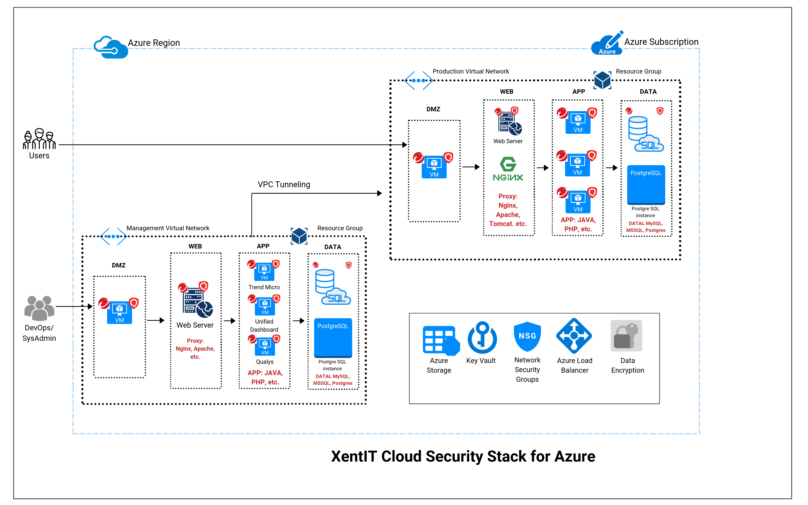
HEALTH CARE CLOUD SECURITY STACK FOR AZURE UNIFIED CLOUD THREAT MANAGEMENT

Slide 5
Stack deliverables and pricing – 12 Month Subscription
DELIVERABLES
Deployment of Qualys Vulnerability Management and Qualys Cloud Agents
Deployment of Trend Micro™ Deep Security™
Configuration of your Healthcare Cloud Security Stack
XentIT Executive Dashboard for unified view of detection and protection
SCOPE
Up to 25 VMs scanned & protected
Annual license for Trend Micro Deep Security Enterprise (IPS, AM, FW, FIM, LI, ML, App Control, Web Reputation)
Annual license for Qualys VM Package (Cloud Agents)
Annual license of XentIT Dashboard (Up to 2 GB data per day) + 16 Hours of Implementation Consulting
30 days of XentIT Level 1, 2 & 3 support
Azure subscription not included
PRICE
$26,995
ASSUMPTIONS
Up to 25 VMs scanned and protected
16 hours of implementation and orientation

Slide 6
Contact us today
Learn more: Healthcare Cloud Security Stack on Azure Marketplace
Call for more information:
410-721-0670
Ask a question via email: azure@xentit.com

