Slide 1
Click2Clone
Clone Dynamics 365/CRM Records in 1 Click
www.inogic.com
crm@inogic.com

Slide 2
Key Features
Configurable
Easy to configure with the ability to select the fields to be carried over along with the prefix and suffix to be added for cloned records.
Deep Copy
Ability to carry over related records from 1:N & N:N relationships.
Get Records
Copy only related records from another record.
Automation
Ability to clone records with Workflow along with data update in new cloned record.
Bulk Copy
Quickly clone multiple records at a time.
Set References
Store reference of the source record on the cloned record and vice versa.
Copy to Another Entity Type
Taking cloning to the next level by allowing details along with the relationships from one entity type record to be copied to another entity type record .
www.inogic.com
crm@inogic.com

Slide 3
Available For
SUPPORTED VERSIONS
MICROSOFT DYNAMICS CRM 2013 AND ABOVE
MICROSOFT DYNAMICS 365
MICROSOFT DYNAMICS 365 v9.0
DEPLOYMENTS
ON-PREMISES
ONLINE
PARTNER HOSTED
www.inogic.com
crm@inogic.com

Slide 4
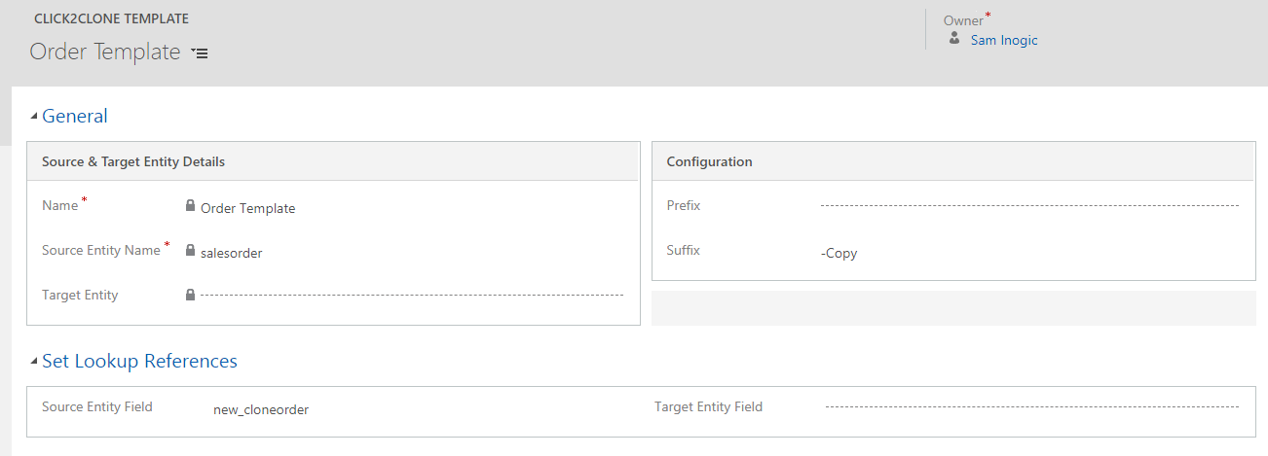
Click2Clone Template Configuration
www.inogic.com
crm@inogic.com

Slide 5
Attribute/Relationships To Clone
www.inogic.com
crm@inogic.com

Slide 6
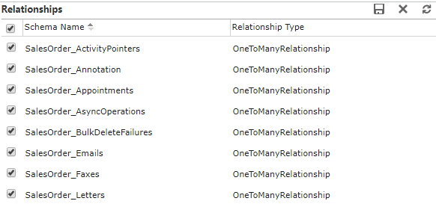
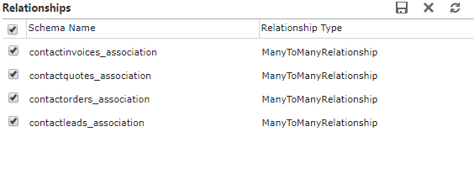
Supported Relationships
Click2Clone Supports
1:N Relationships
Click2Clone Supports
N:N Relationships
www.inogic.com
crm@inogic.com

Slide 7
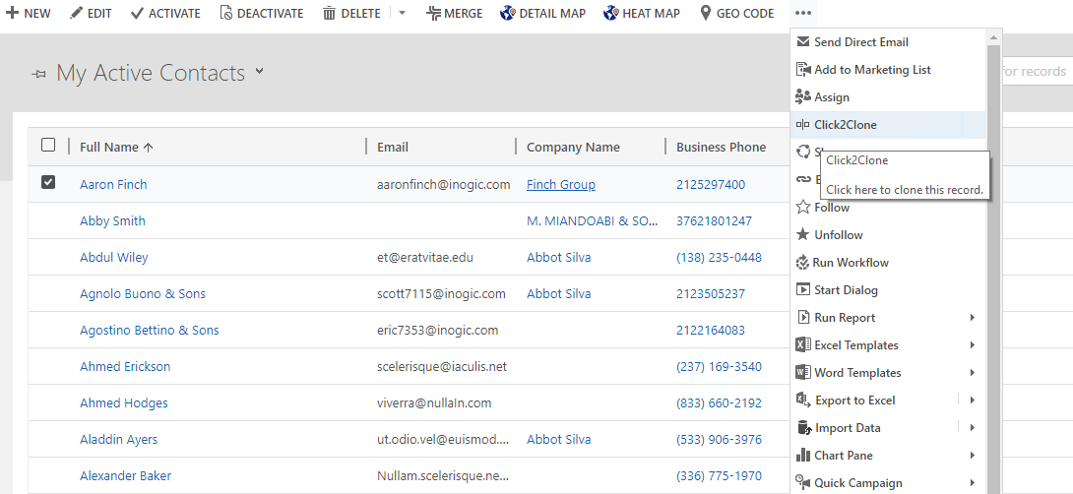
Ease Of Access From Ribbon On Form and Entity Home Page
www.inogic.com
crm@inogic.com

Slide 8
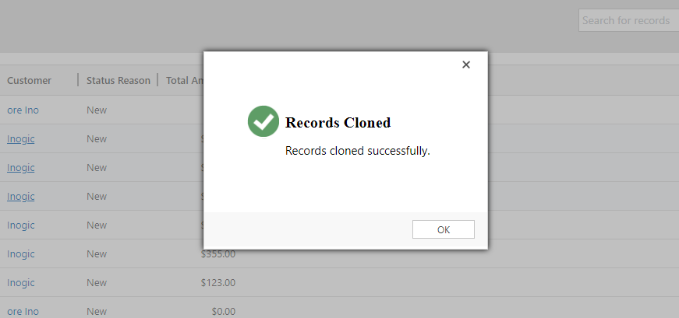
Bulk Copy
www.inogic.com
crm@inogic.com

Slide 9
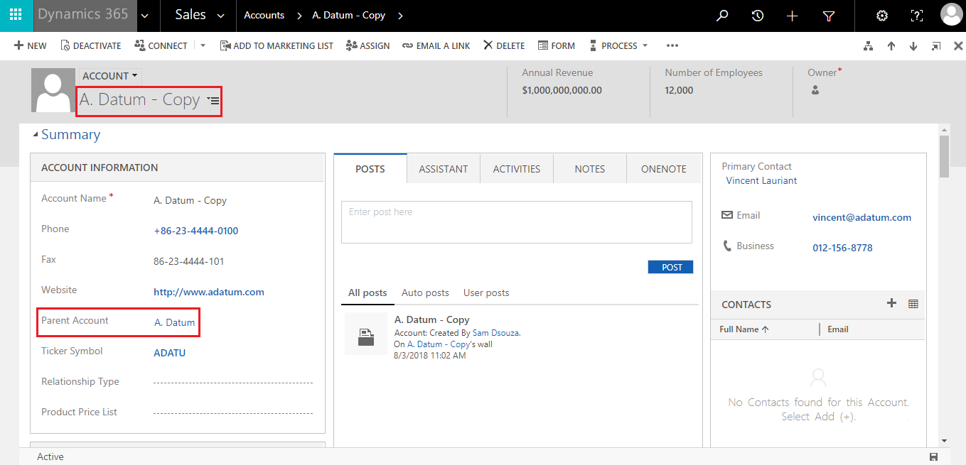
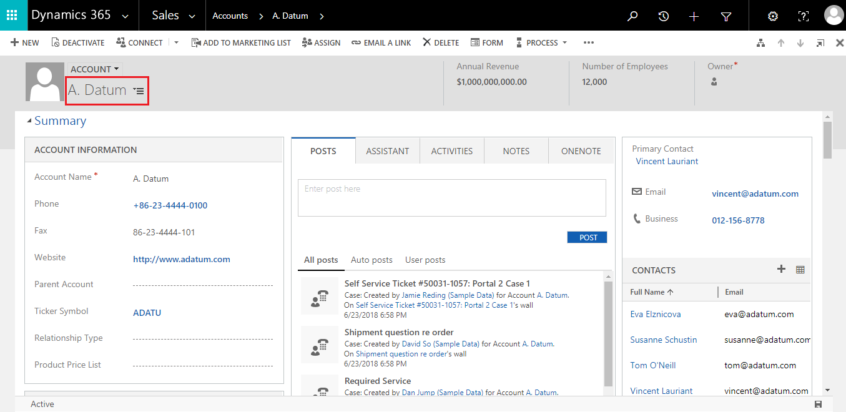
Set References
www.inogic.com
crm@inogic.com

Slide 10
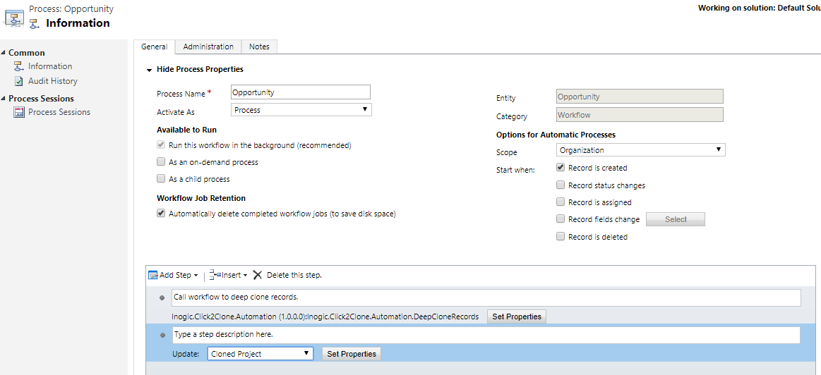
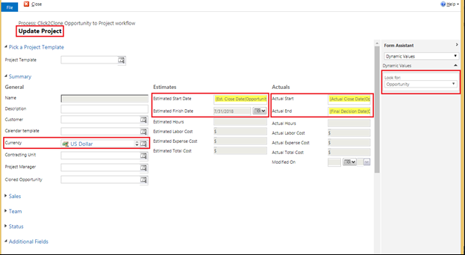
Automation and Update the Cloned record with Click2Clone Workflow
www.inogic.com
crm@inogic.com

Slide 11
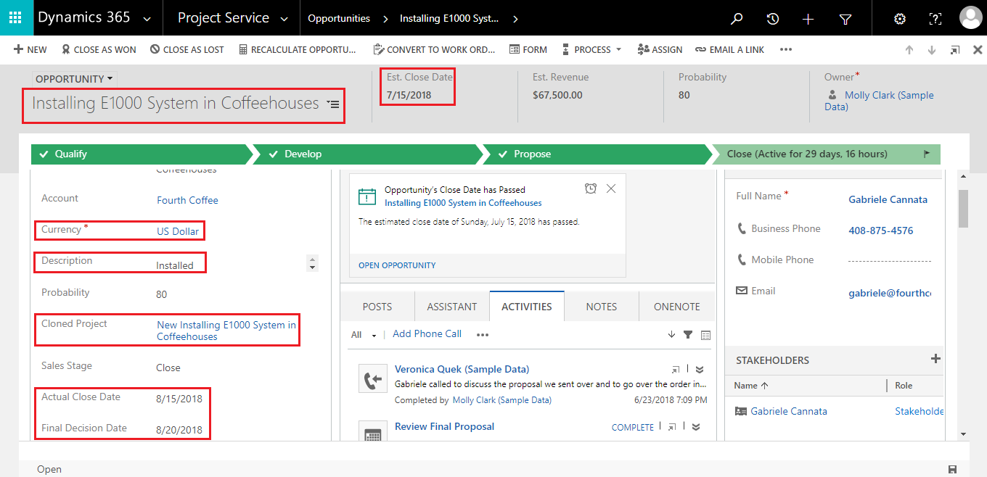
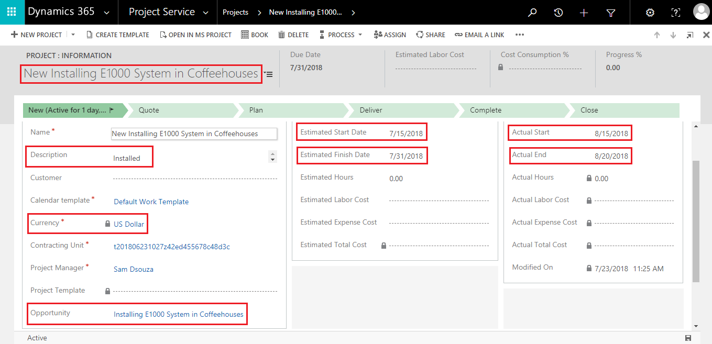
Clone record details along with relationship from one entity to other entity
Selected Opportunity
Cloned Project
www.inogic.com
crm@inogic.com

Slide 12
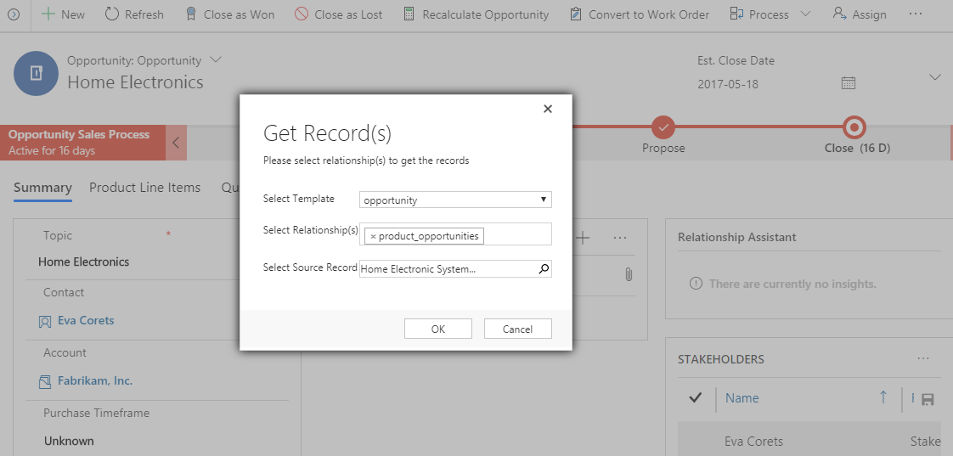
Copy only related records from another record
www.inogic.com
crm@inogic.com

Slide 13
Next Steps
Learn more about Click2Clone today.
Get your free Click2Clone trial now!
Get started with Click2Clone Videos
Email: crm@inogic.com
www.inogic.com
crm@inogic.com

