Slide 1
Dynamics 365 – mailup connector

Slide 2
INDex
Introduction
Navigation Path
Account/List configuration
Placeholders
Template Generation
Single Sends
Campaign Configuration
Subscriptions
Dashboards

Slide 3
Introduction

Slide 4
Introduction
Dynamics 365 – mailup connector
In this manual we represent and detail all features related to the installation of the new component «Dynamics 365 – MailUp Connector» within Microsoft Dynamics 365
The new solution allows to use MailUp’s simple and scalable features to create, automate, and personalize Email & SMS within Dynamics 365.

Slide 5
Navigation Path

Slide 6
Mailup Connector
The user, once logged in in to the system (through its credentials), uses the following navigation path in order to view MailUp functionalities.
In the workspace, the user clicks on "MailUp Connector“ box
These are the components displayed in this section

Slide 7
MailUp Connector Sections
Communication area
Definition of dynamic fields
External Mailup link
Template Creation area
Account Configuration area

Slide 8
Account/List configuration

Slide 9
Settings
Within the configuration section user can:
Configuring Administrator Account
Entering personal credentials for individual accesses
Managing List

Slide 10
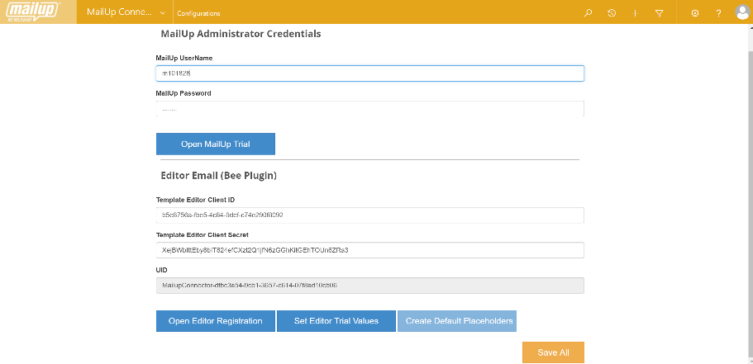
Account Administrator
If user has already the credentials, he has to insert the login credentials related to the MailUp Administrator account
The user can request and associate a Mail up test version
Only administrators can view and make changes to the "Configurations" section
Automatic creation of default placeholders
By clicking the button,user can embed the MailUp email editor
Automatically set up 'Trial' codes in order to use email editor
After having configured the account, user can "Save“

Slide 11
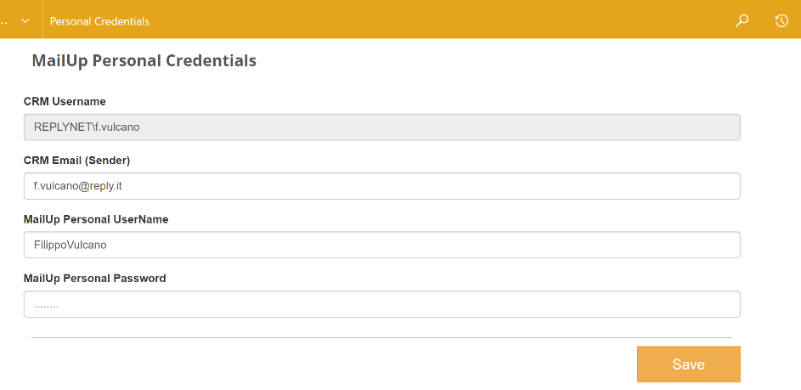
Personal credentials
Email address associated to the account
If user has already its credentials he can insert them in order to access MailUp
After having saved the information, system will send a verification email to the specified address

Slide 12
View MailUp Lists
The synchronization list is automatic only for “Pro” version
User clicks on the button in order to synchronize MailUp lists in Dynamics 365
All associated lists

Slide 13
Placeholders

Slide 14
Placeholders
In Placeholders section, user can visualize and add new dynamic fields in order to use them for templates. Dynamic fields are related to Accounts, Lead and Contact entities of Microsoft Dynamics 365

Slide 15
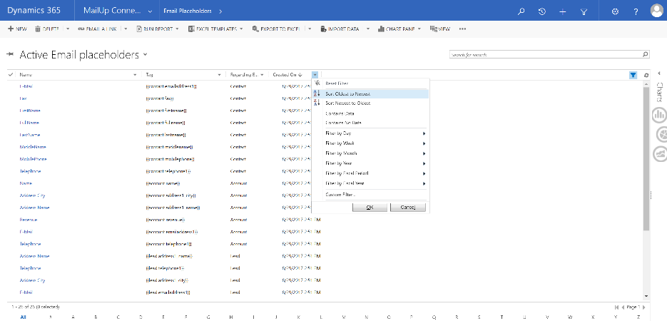
Email placeholder
User clicks on Email Placeholders
System allows to select the reference view
Search box
In the view are present both manually and default records created by the system
By clicking on 'Filter‘, user can activate for each field the possibility to set specific filter criteria.

Slide 16
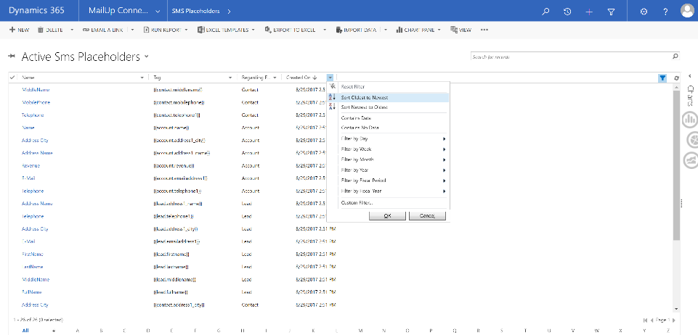
Sms placeholder
User clicks Email Placeholders
Search box
System allows you to select the reference view
In view are visualized both the manually and default records created by the system
By clicking on 'Filter‘, user can activate for each field the possibility to set specific filter criteria.

Slide 17
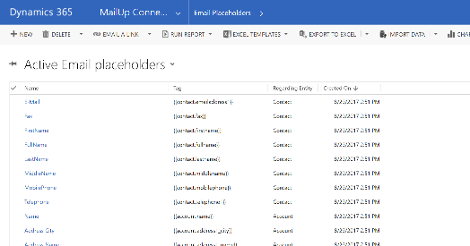
Creating a new placeholder
Within the main view, user clicks «New»
After having inserted all the required information, the user clicks Save
Through the tag, user specifies the field from which retrieve the information
Record name
The creation activity works for both contact modes (Email, SMS)
Regarding entity from which taking the information. User can select:
Lead
Account
Contact
This characters sequence must be in the following format: {{RegardingEntity.Namefield}}

Slide 18
Template Generation

Slide 19
Templates
Within the Templates area, user can view all templates or create other ones in order to use them in Email or SMS communications.

Slide 20
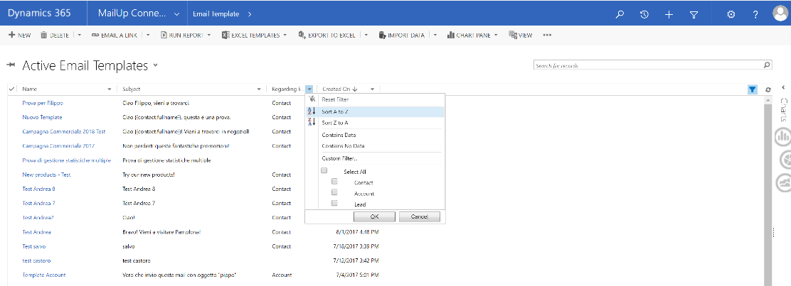
Template view
The system allows you to select the reference view
Search box
Search / filter features are available also in the SMS view
By clicking on 'Filter‘, user can activate for each field the possibility to set specific filter criteria.

Slide 21
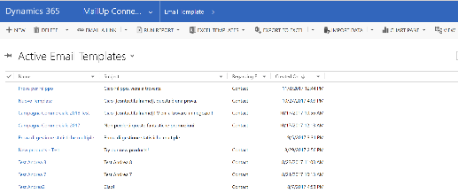
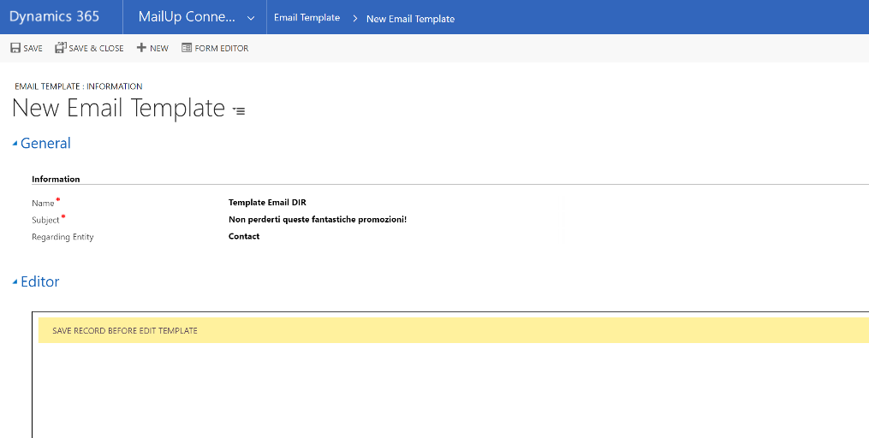
Create email template
Within the main view, user clicks «New»
After having inserted all the required information, user clicks «Save»
Template Name
Only after saving record user can use the features of the HTML editor
Regarding entities to specify for creating dynamic templates. The only possible values to select are:
Contact
Account
Lead

Slide 22
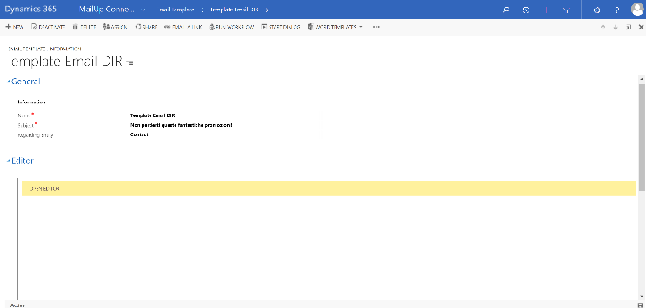
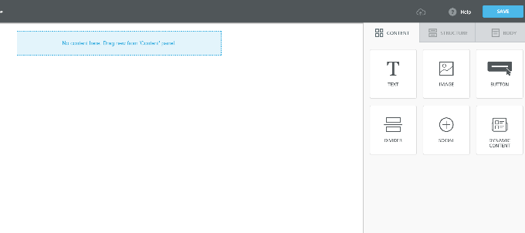
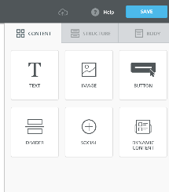
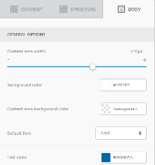
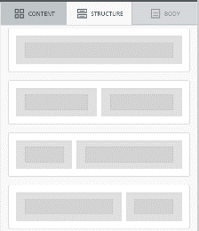
Open editor Email
Area in which user can drag the elements presented in the control panel
Control panel area
Within the editor, user can use simple drag and drop operations to configure the template

Slide 23
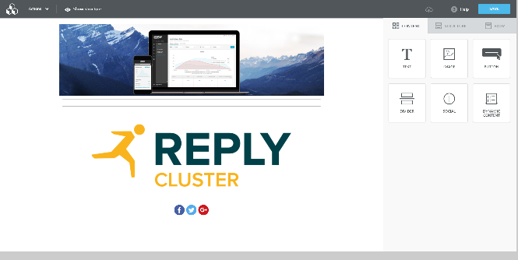
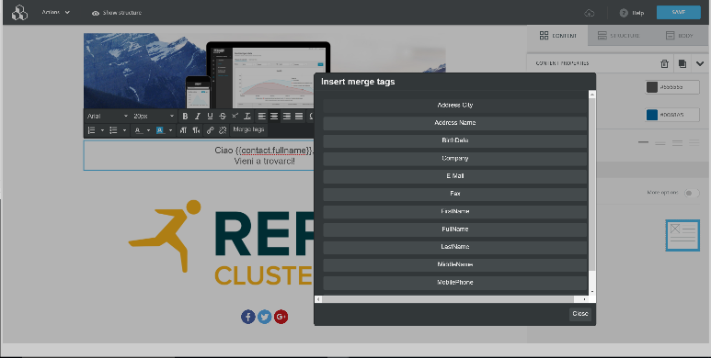
Drag and Drop email
By inserting a text area, user can specify a dynamic field in the body message by clicking on "Merge tags"
User, by dragging the different elements from the control panel, can set:
the content
structure
In order to specify a dynamic field, it must be present in the Placeholder section and the related entity must be selected during the creation

Slide 24
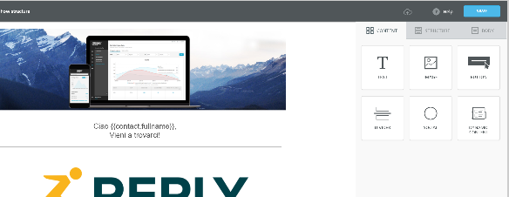
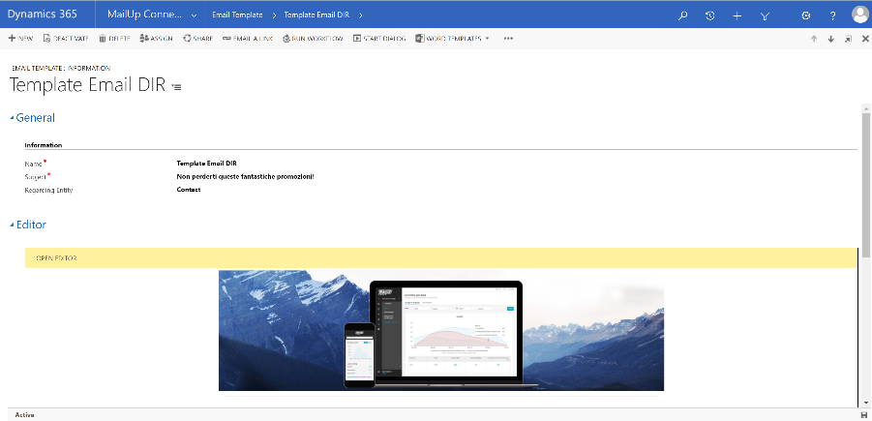
view template email
After having configured the template, user clicks on «Save»
System updates the template page; user visualizes in two different sections (Editor, HTML) both the template created and its html code
Once created and saved, contents and images loaded in the email editor are visible for each Business Unit

Slide 25
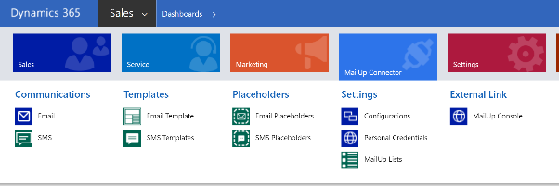
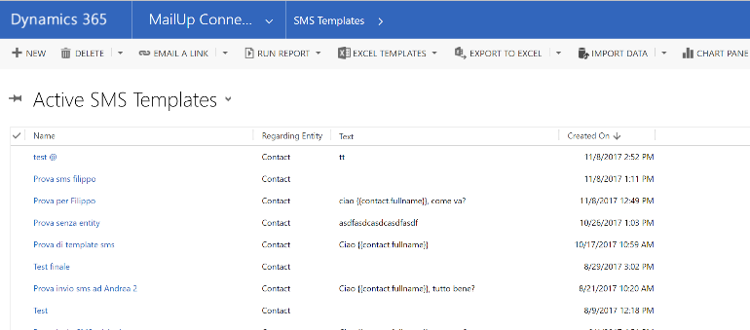
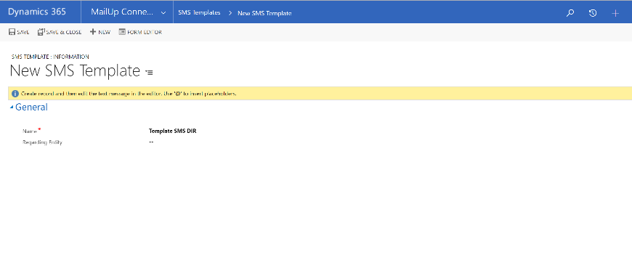
Create sms template
User clicks «new» to create a new template
After having inserted all the required information, user clicks «Save»
Name
Regarding entities to specify for creating dynamic templates. The only possible values to select are:
Contact
Account
Lead
If «Regarding Entity» field is populated, the record is automatically saved

Slide 26
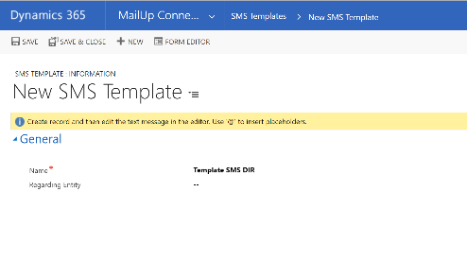
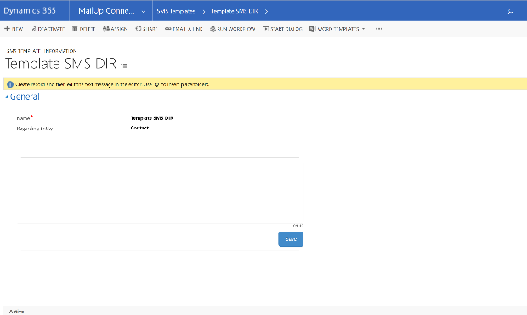
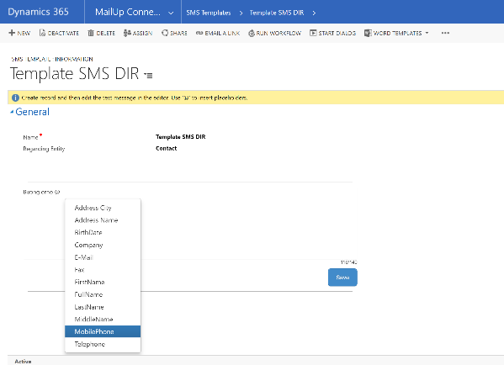
message and dynamic fieds
System displays a new area in which user can specify the message
In order to enter a dynamic field, user inserts the @ symbol and selects the related placeholders
User can enter only the placeholder configured according to the specified entity
User clicks on «Save» in order save the message

Slide 27
Single sends

Slide 28
Single Sends
In communication section user can:
Visualize all the email/sms managed
Create new single email/sms

Slide 29
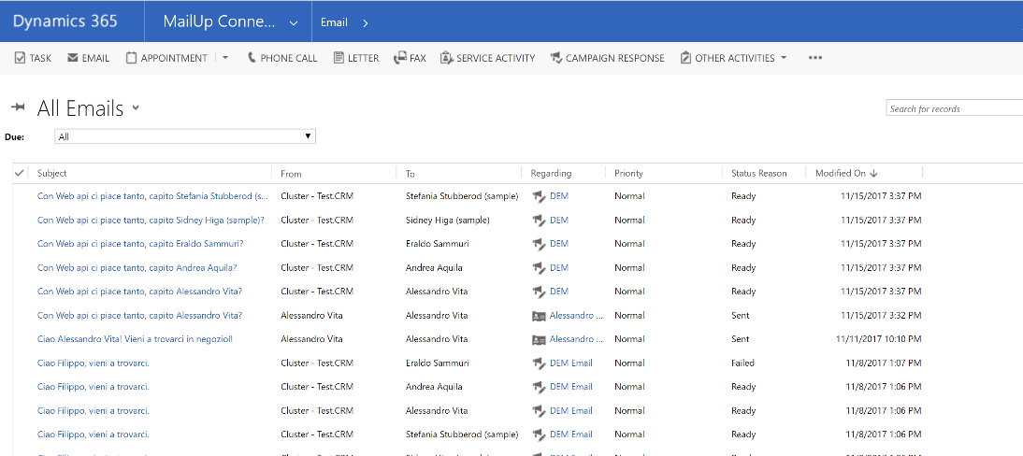
Email View
User visualizes the recipient of the communication
User visualizes the sender of the communication

Slide 30
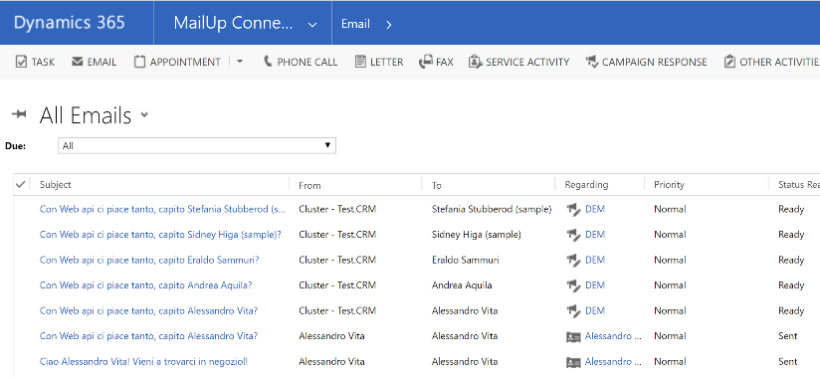
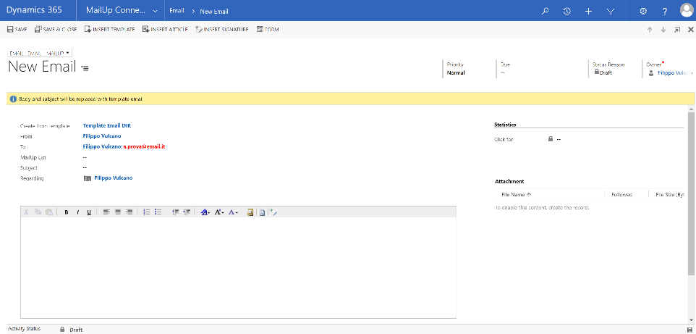
CreatE new Email
User clicks on Email
User selects the template to use
If it has been already inserted a template it is not necessary inserting none information in the object and body message
Contact, Account, Lead

Slide 31
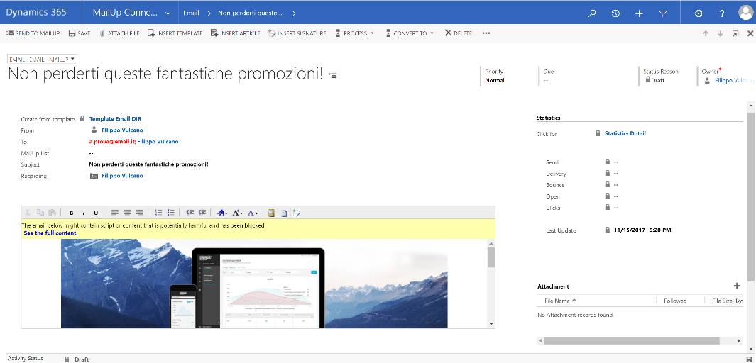
Template association
After having inserted all the required information, user clicks «Save»
System automatically inserts the template populating dynamic fields

Slide 32
EMAIL SEND
User clicks «Send to MailUp» to send the email
Within the main view, the user can visualize emails previously sent and their status

Slide 33
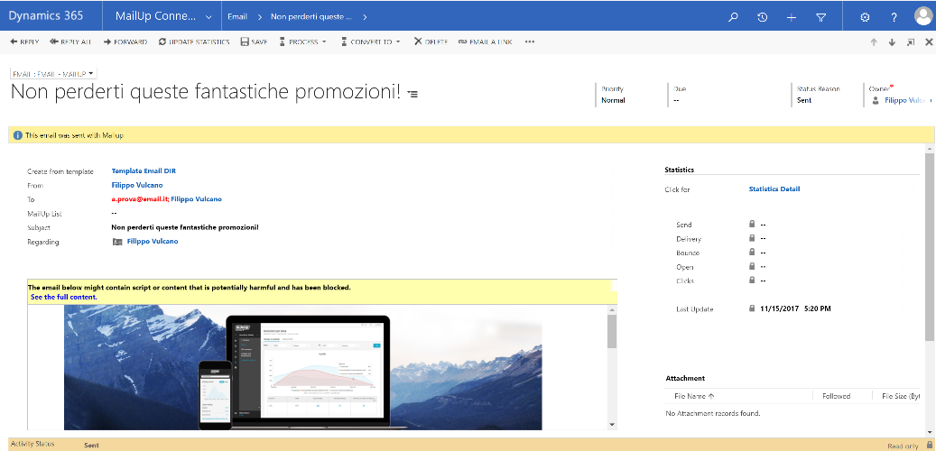
Mailup Email Statistics
Statistics counter

Slide 34
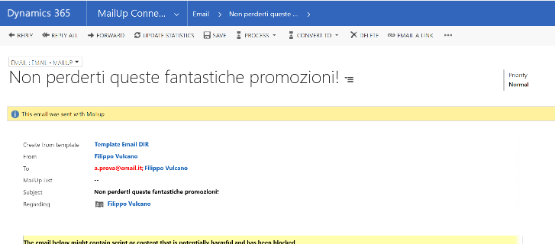
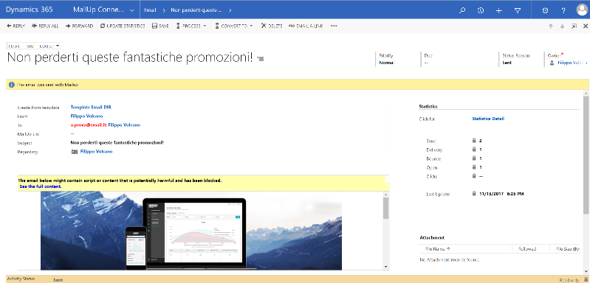
Statistics MailUp UPDATE
User clicks «Update Statistics»
System updates all the information according to the data on MailUp. It will be displayed all data about the number of:
emails sent
emails delivered
email not delivered
openings
click on any existing link
In the PRO version, the update is automatically performed by the system

Slide 35
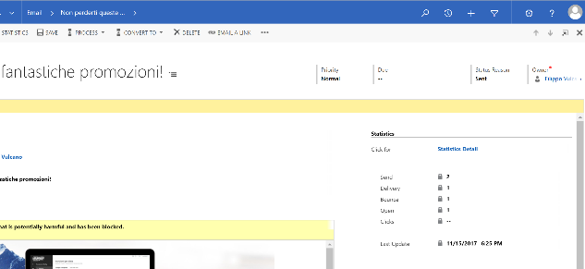
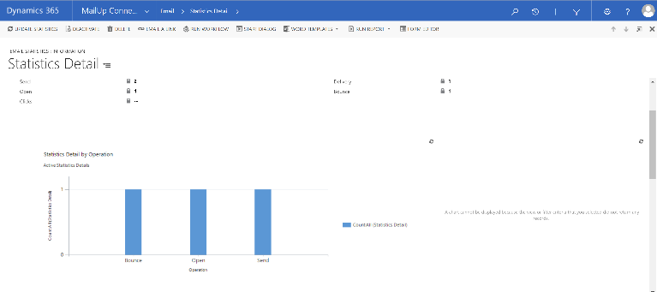
Statistics mailup
By clicking on the record the user can see the details of the statistics
Related MailUp statistics are also present within the related contact

Slide 36
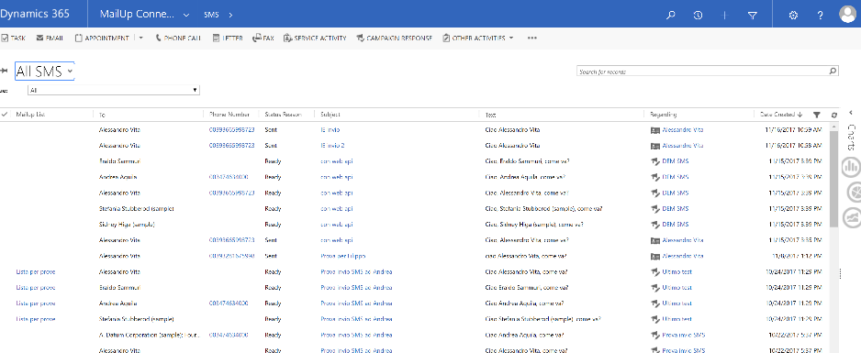
SMS VIEW
State of the record
Communication recipient
Search, filter, and display selection features described in slide 20 are available
It is possible to select specific views to display

Slide 37
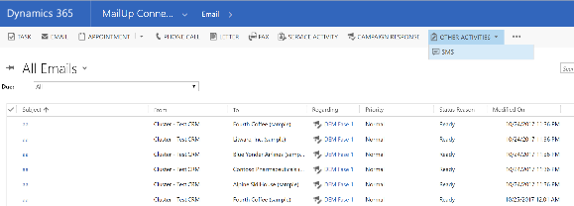
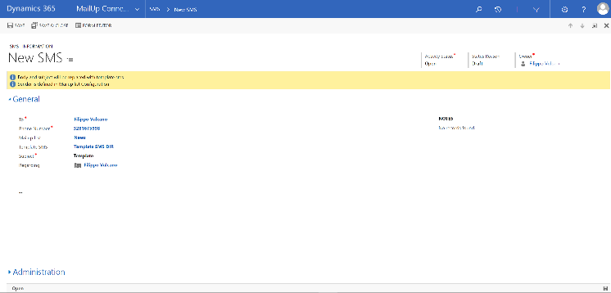
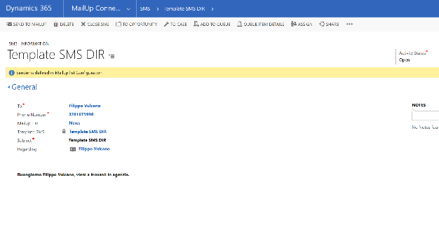
CreaTE A NEW SMS
System populates the field automatically after having inserted recipient
User can use a template already on the system
If a SMS template is used, user must specify its reference record in the "Regarding" field
The system inserts automatically the message if a template has been inserted
Area where you can enter the message

Slide 38
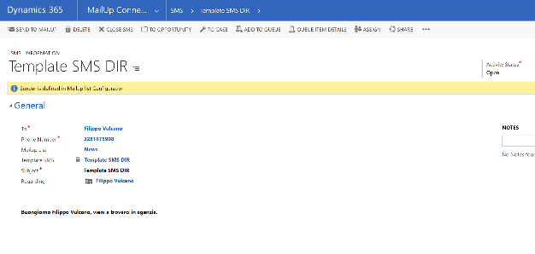
Invio SMS
User selects «Send to MailUp»
Within the main view, user can view the single SMS previously sent and their status

Slide 39
Campaign configuration

Slide 40
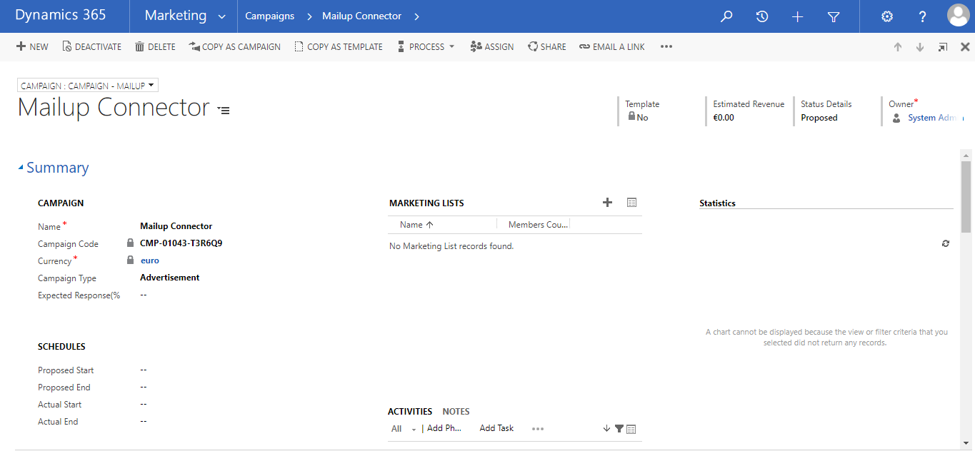
Campaign
Features related to the MailUp connector can also be used within a generic campaign. Through this new configuration, user can evaluate/analyze the contact results (detail statistics) in the generic campaign in order to evaluate the interest in the submitted proposals.
Sending of Emails and SMS associated with campaigns is only provided with the PRO version of the connector
The subject of a campaign can contain a maximum of 20 characters

Slide 41
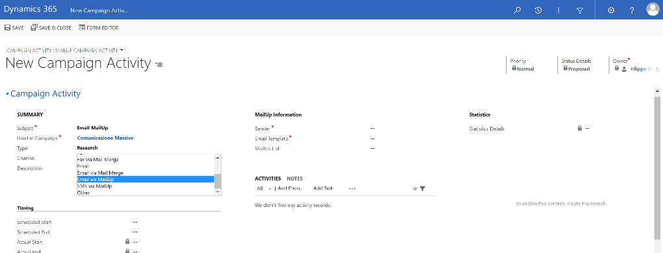
Campaign Activity
After you have created a campaign and associated its related target (Marketing Lists), you can specify, within a generic activity (campaign activity), the following contact channels :
Email via MailUp
SMS via MailUp

Slide 42
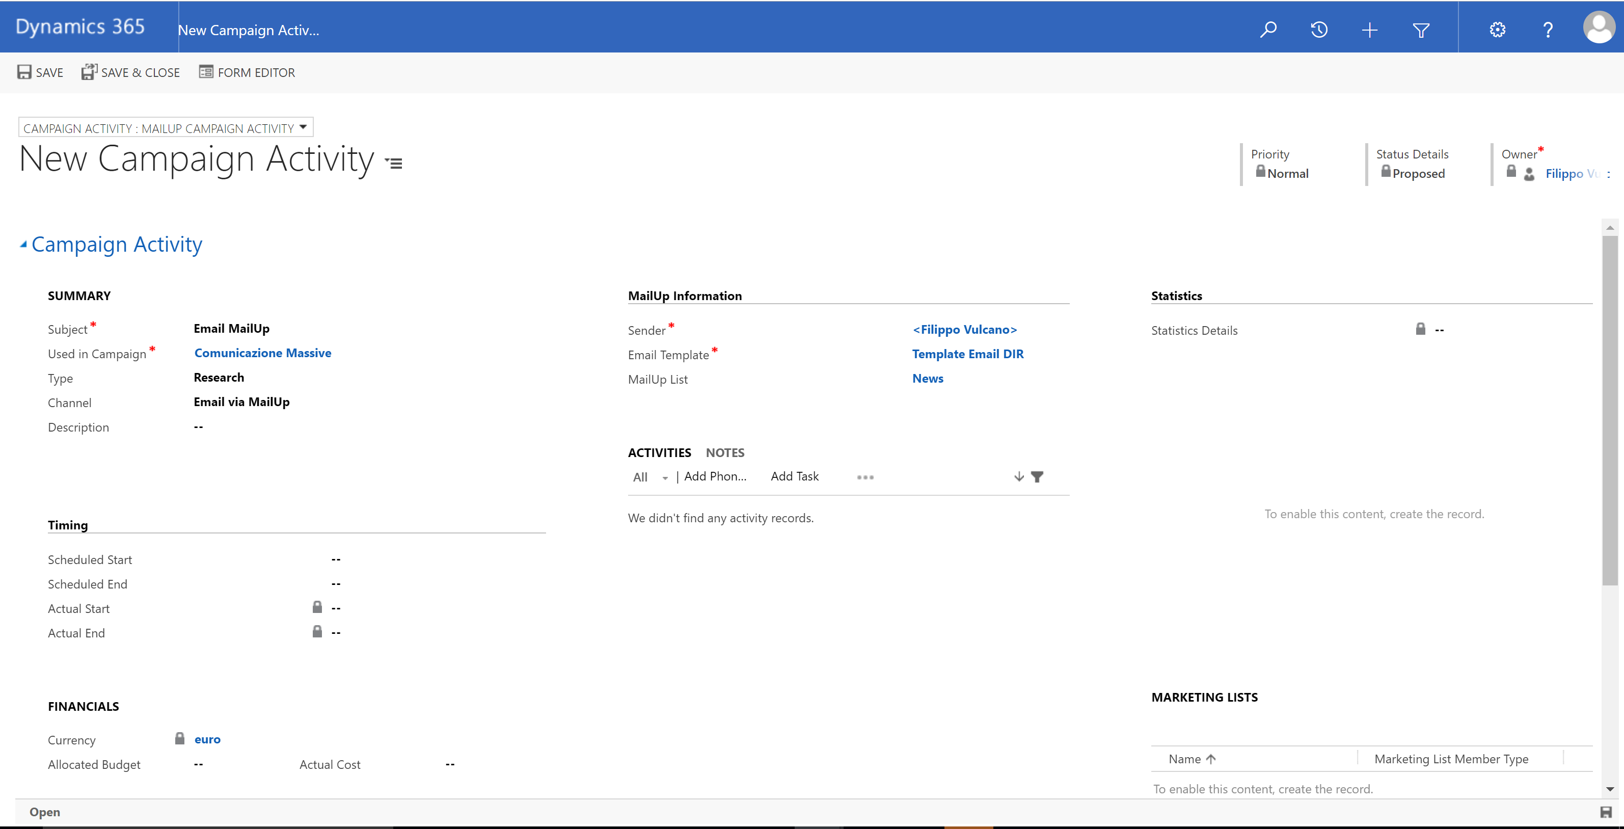
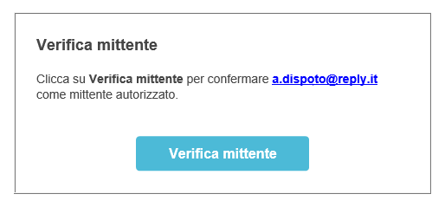
Mailup email
The subject of a campaign ACTIVITY can contain a maximum of 10 characters.
After having inserted all the informations click on «Save»
User selects «Email via MailUp»
If the sender is not approved by Mailup, a validation request, that must be approved to validate the sender, will be sent during the campaign mailing phase
to the email address entered.
User inserts sender and template to use

Slide 43
mailup email
User can distribute tasks
System automatically populates the «statistics Details» field

Slide 44
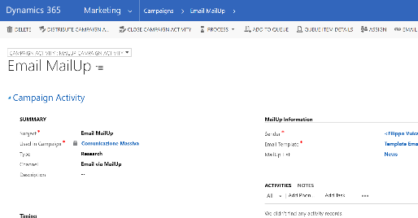
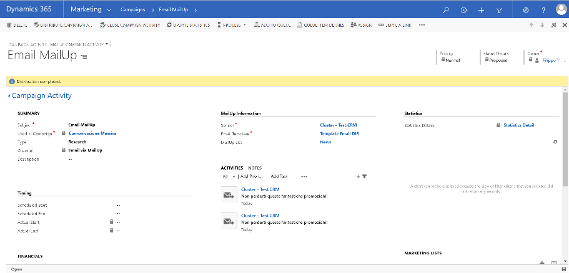
ACTIVITY VIEW
System creates its records within the activity section

Slide 45
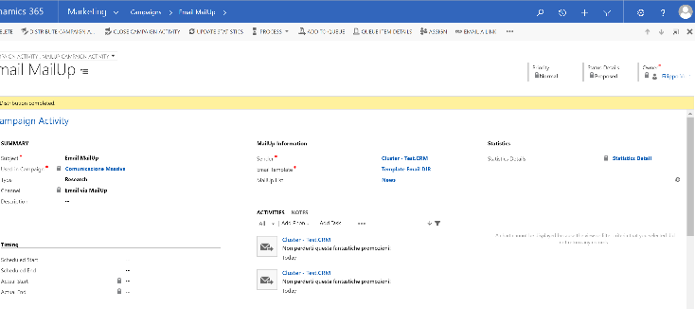
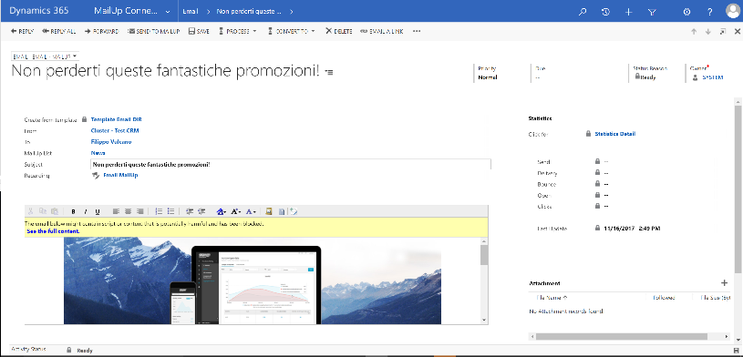
Email VIEW
To view the email, user can open the activity or use the view described in slide 29
In the Light version, you can not send emails associated with campaigns; This feature is available with PRO version of the connector.

Slide 46
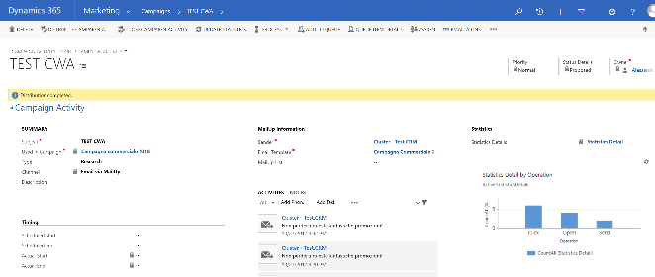
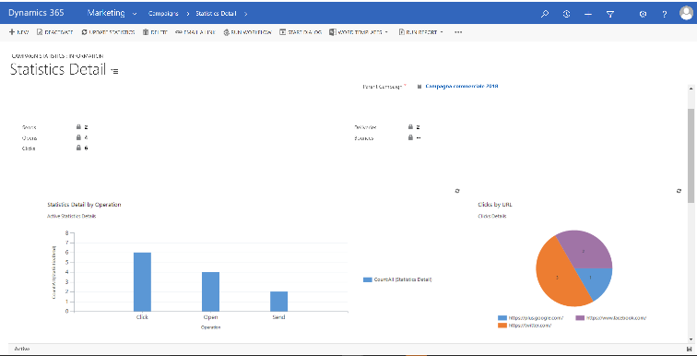
campaign activity statistics
User can view the details

Slide 47
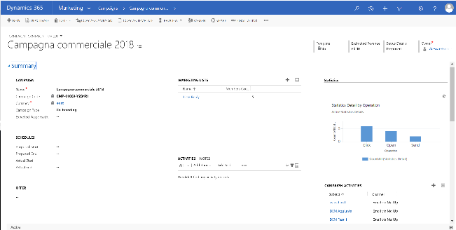
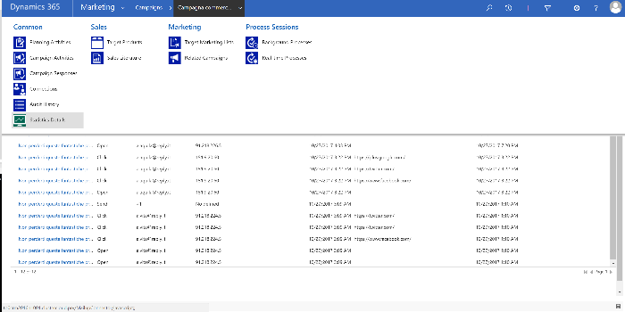
Campaign statistics
User can see the graphical representation of campaign-related statistics
To see the detail, you can use the 'Statistics Details' box associated to the campaign

Slide 48
SUBSCRIPTIONS

Slide 49
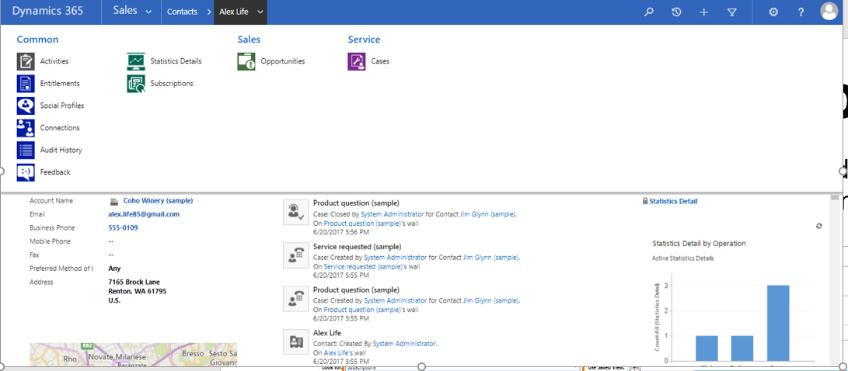
SUBSCRIPTIONS
It is possible to view the subscriptions associated to a given Mailup list and to a reference entity (Account, Contact or Lead) by the module of the same entity
To view the subscription details, the user selects the «Subscriptions» box associated with the Accounts, Contact or Leads
User can select a Subscription record from the associated view

Slide 50
SUBSCRIPTIONS
User displays if an Account, Contact or Lead has an email and/or SMS subscription.
Subscriptions are updated daily

Slide 51
dashboards

Slide 52
dashBOARDS
User displays the Mailup Connector Dashboards, that show the status of some features of the Mailup connector, such as the Mail ready to be sent( in Ready state), the Active Logs, the number of errors sorted by date, active campaigns with distribution in progress, and the number of simultaneous operations (active logs in the last hour)
User displays the active logs view
User displays, for each campaign, the Email message ready to be sent

Slide 53
DASHBOARDS
User displays for each user, the number of email message ready to be sent
Users displays campaign activities with distribution in progress
User displays errors sorted by date
User displays the simultaneous operations number ( active logs in the last hour

